Slide 1

Early Help
Assessment and Plan
GUIDANCE
1st August 2019

Slide 2
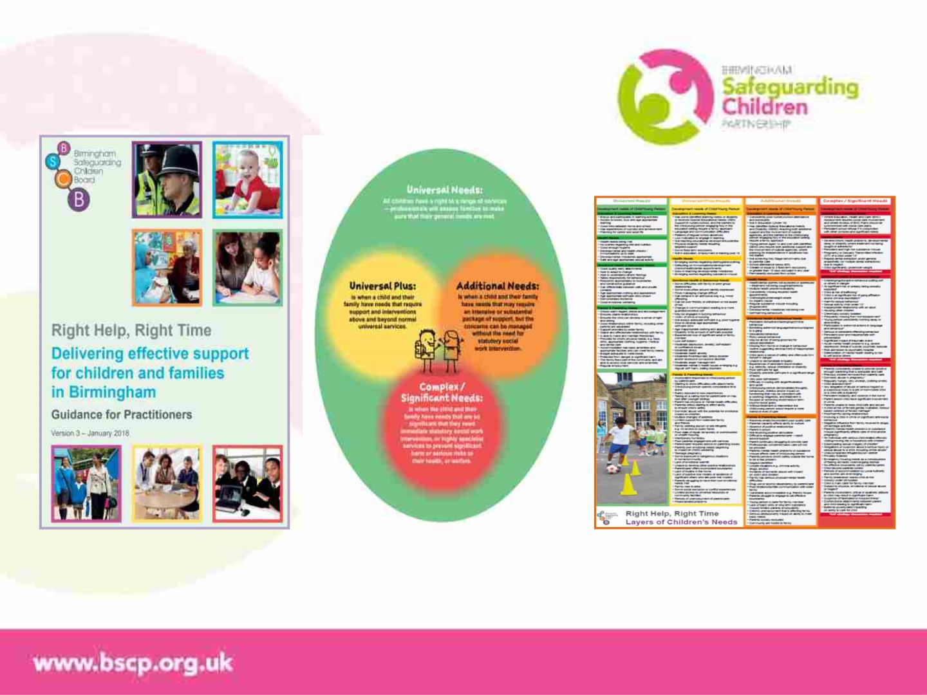
Early Help?
Birmingham Safeguarding Children Partnership – Right Help, Right Time

Slide 3
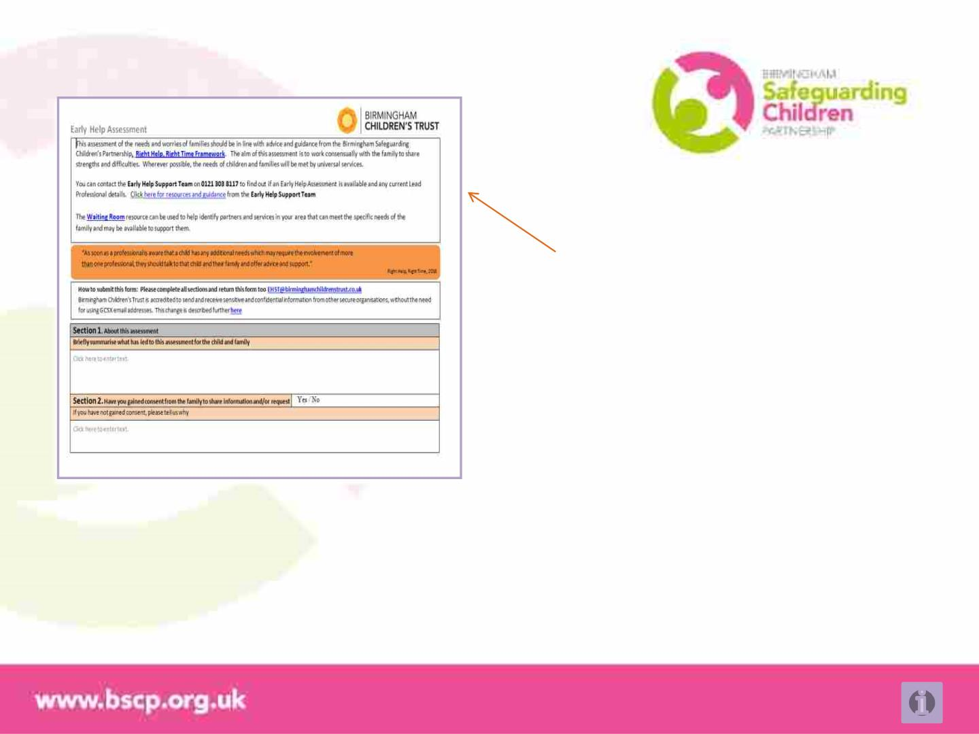
The Early Help Assessment
This is a general guide to completing the Early Help
Assessment and Plan
The document is available here from the
Birmingham Safeguarding Children Partnership
THE ASSESSMENT WILL ONLY BE AS GOOD AS YOUR CONVERSATION WITH THE FAMILY
EHA and Plan online information

Slide 4
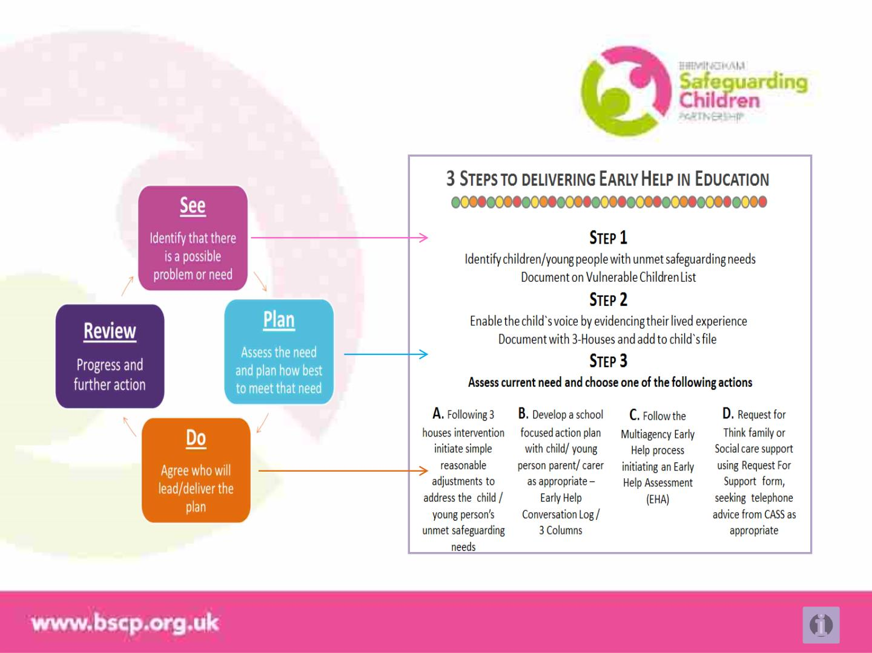
The Early Help Actions
EHA and Plan online information

Slide 5
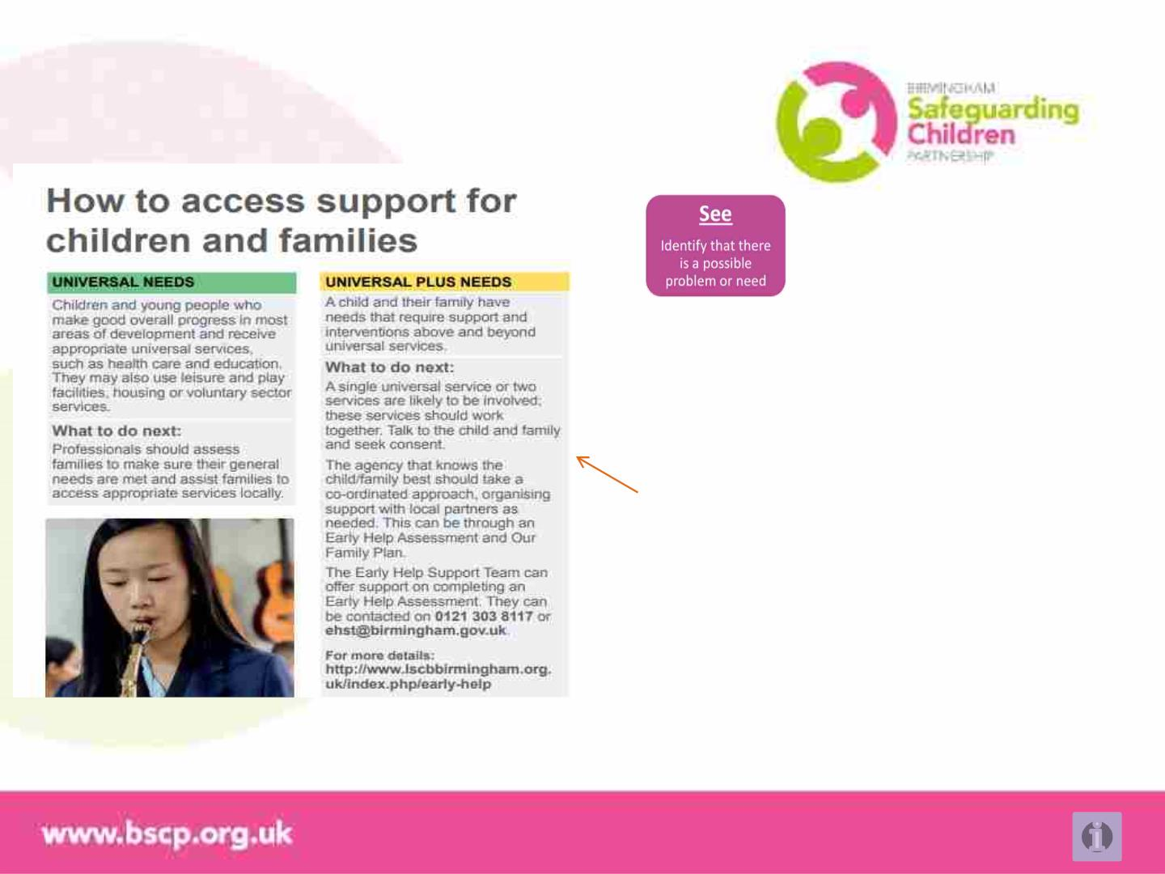
When to start an Early Help Assessment
Where behaviours may indicate vulnerability, this
document should be used
Universal Plus Needs would benefit from an
Early Help Assessment to ensure support early
and provide information if things escalate
Making the assessment core to your recording
and response early in your support helps better
engagement, consent, sharing and aids plans
that draw on greater understanding of the
family’s needs and what drives these.
A simple approach would be The Early Help
Actions
Birmingham Safeguarding Children Partnership – Right Help, Right Time
EHA and Plan online information

Slide 6
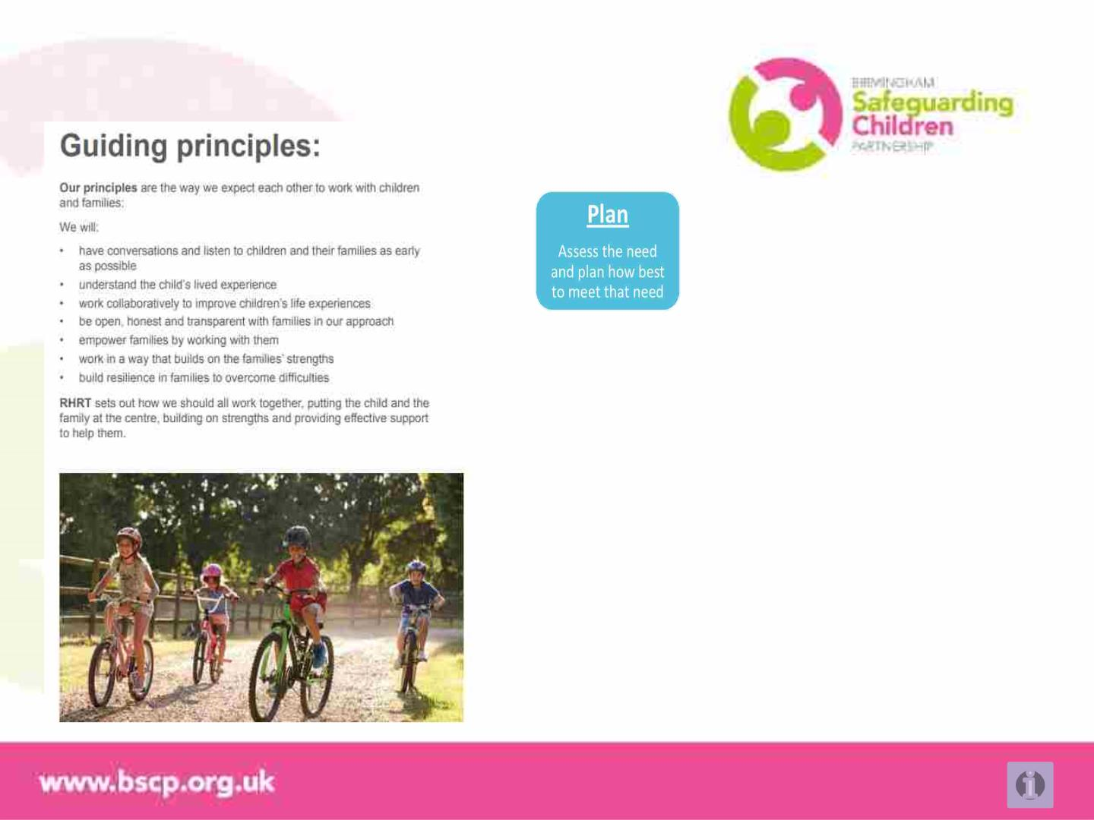
Starting the Assessment and Plan
Right Help, Right Time gives us a set of principles
to adopt
Your understanding of the child or family’s need is
the start of an assessment, your response and what
you do, is the beginning of a plan
Crucial to the right help at the right time is the right
conversation with the child and family
A family’s privacy is important and drawing their
attention to how seriously we take this will help you
have open and honest discussion with them
EHA and Plan online information

Slide 7
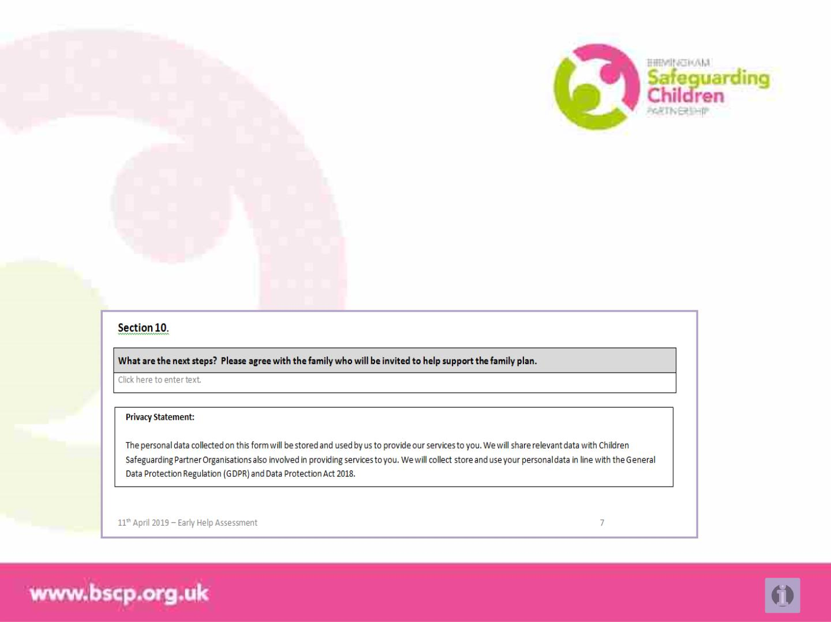
Starting the Assessment and Plan
Privacy Notice
“The personal data collected on this form will be stored and used by us to provide our services to you. We
will share relevant data with Children Safeguarding Partner Organisations also involved in providing
services to you.
We will collect store and use your personal data in line with the General Data Protection Regulation
(GDPR) and Data Protection Act 2018”
EHA and Plan online information

Slide 8

Starting the Assessment and Plan
Privacy Notice
Click the link in the bar below for the Early Help Assessment
and Plan information and example EHAs online from
Birmingham Safeguarding Children Partnership – Right Help, Right Time
EHA and Plan online information

Slide 9
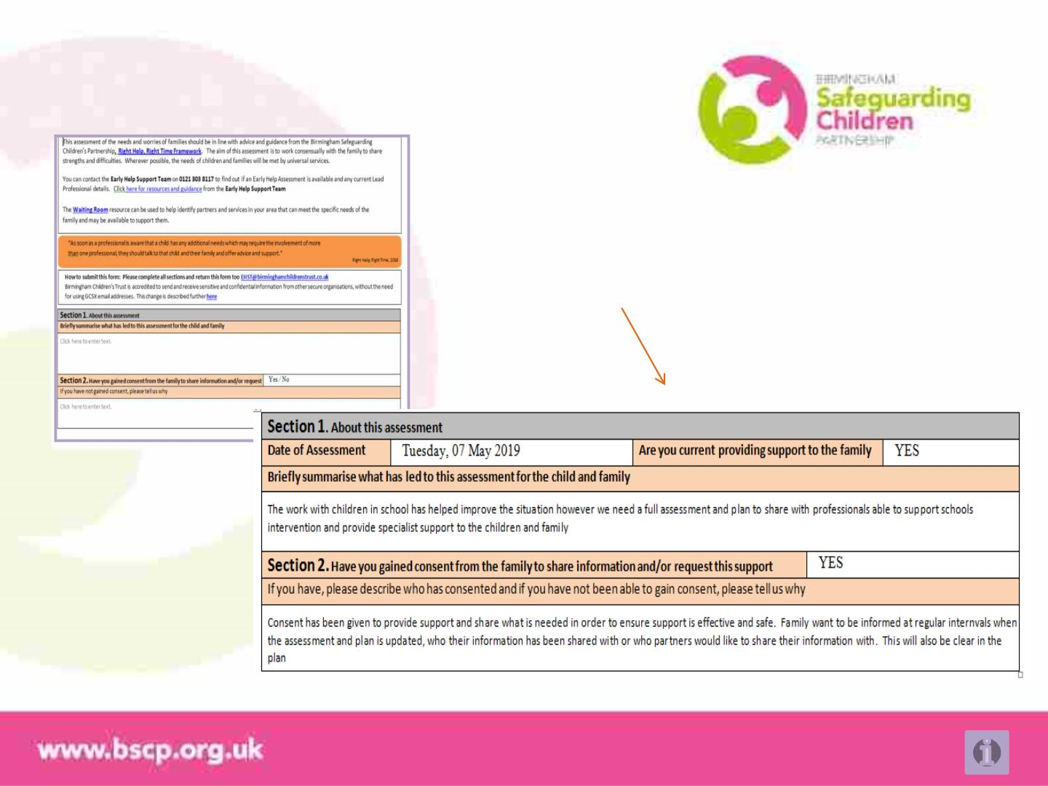
The Early Help Assessment
An example, keeping to the privacy statement, of the
consent in Section 1 and 2 of the Early Help
Assessment
EHA and Plan online information

Slide 10
Starting the Assessment and Plan
Consent & Public Task or Duty
It is important that families understand exactly what they are consenting to. This includes any adult with
parenting responsibility and where age appropriate, young people themselves.
Families should be:
• happy to participate in an early help assessment and plan
• understand the information will be used to help ‘plan’ and share actions for themselves and others
• give permission for information to be shared with professionals that can provide support to them
• understand that information will be stored safely and in accordance with legislation
• know that where there is an immediate risk of harm, we have a duty to act and share information
• appreciate that some information can be kept from others and some must be shared, to keep children
and families safe from harm or risk and that we will discuss this with them
EHA and Plan online information

Slide 11
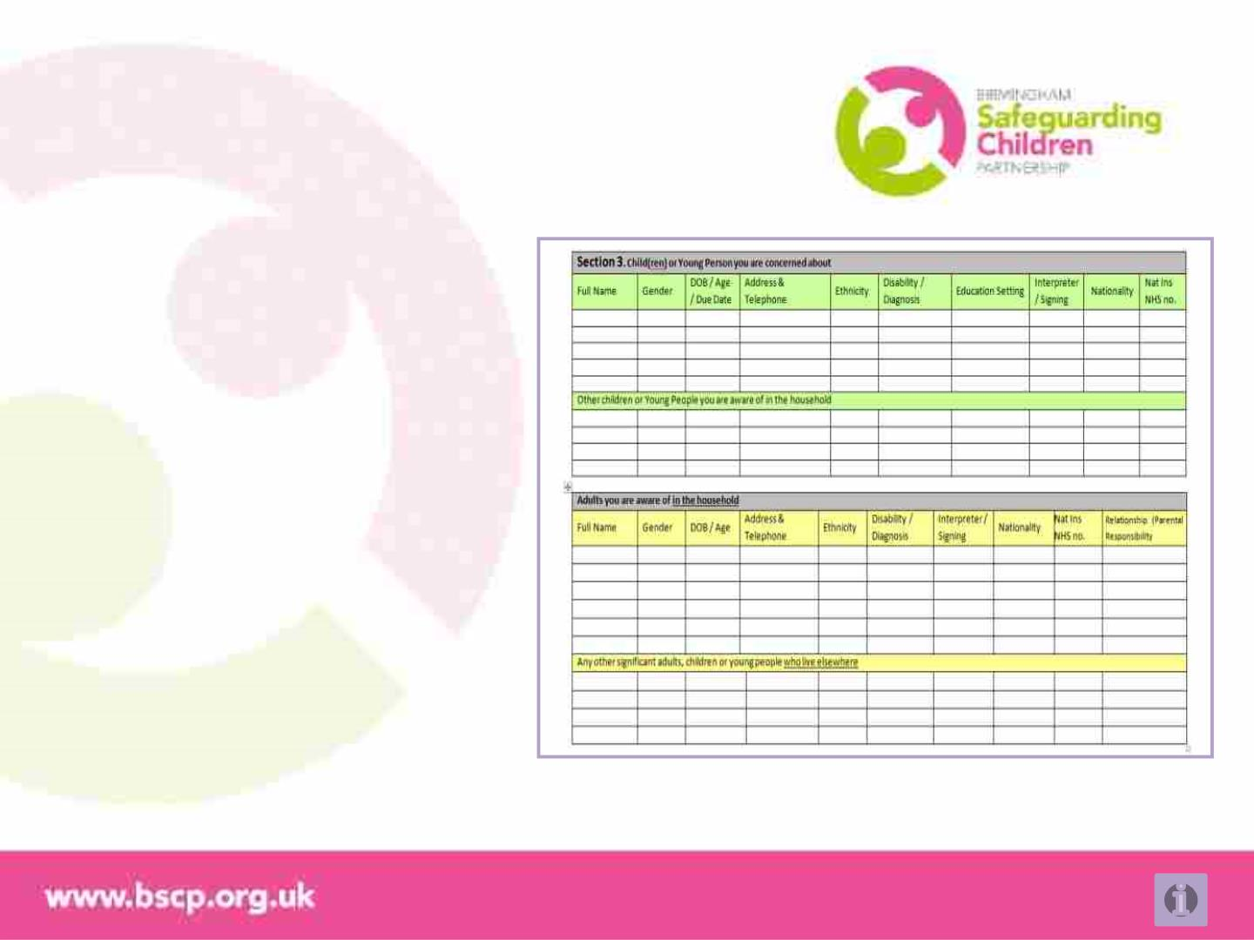
Early Help Assessment
Completing the form, section 3
Section 3
These are the details of the child or
children in the family (under 18) and others
in the home if not related
Details of adults in the household as well
as if they have parental responsibility,
followed by other significant adults around
the family and children
These details help ensure we understand
who is in children’s lives, that adults in the
parents network are known and
appropriate or can support – so children
are safe
EHA and Plan online information

Slide 12
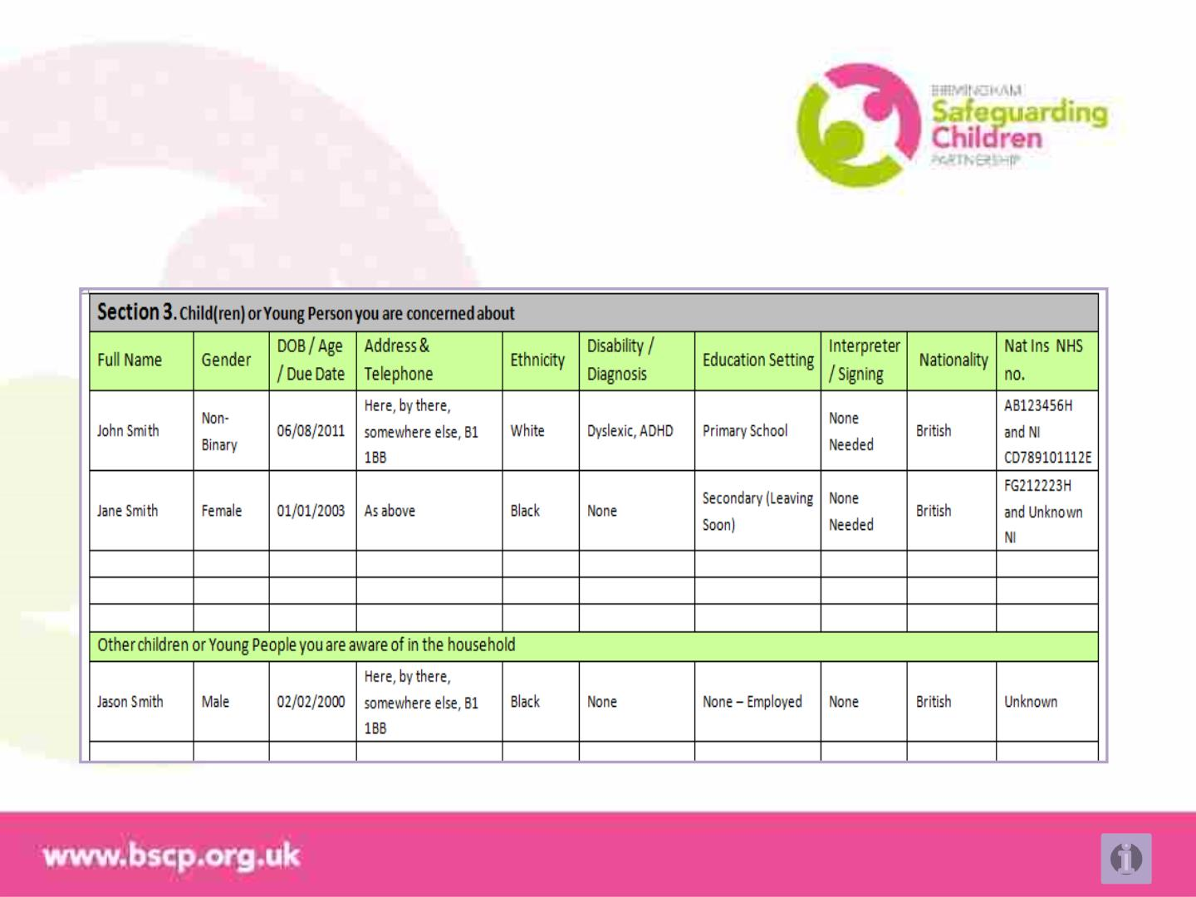
Early Help Assessment
Example of the form, section 3
EHA and Plan online information

Slide 13
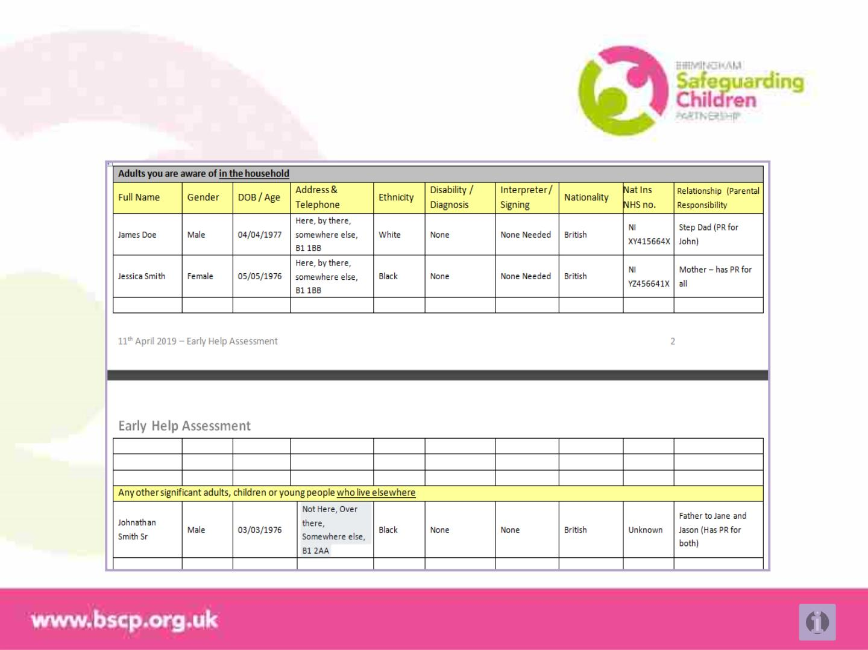
Early Help Assessment
Example of the form, section 3
EHA and Plan online information

Slide 14
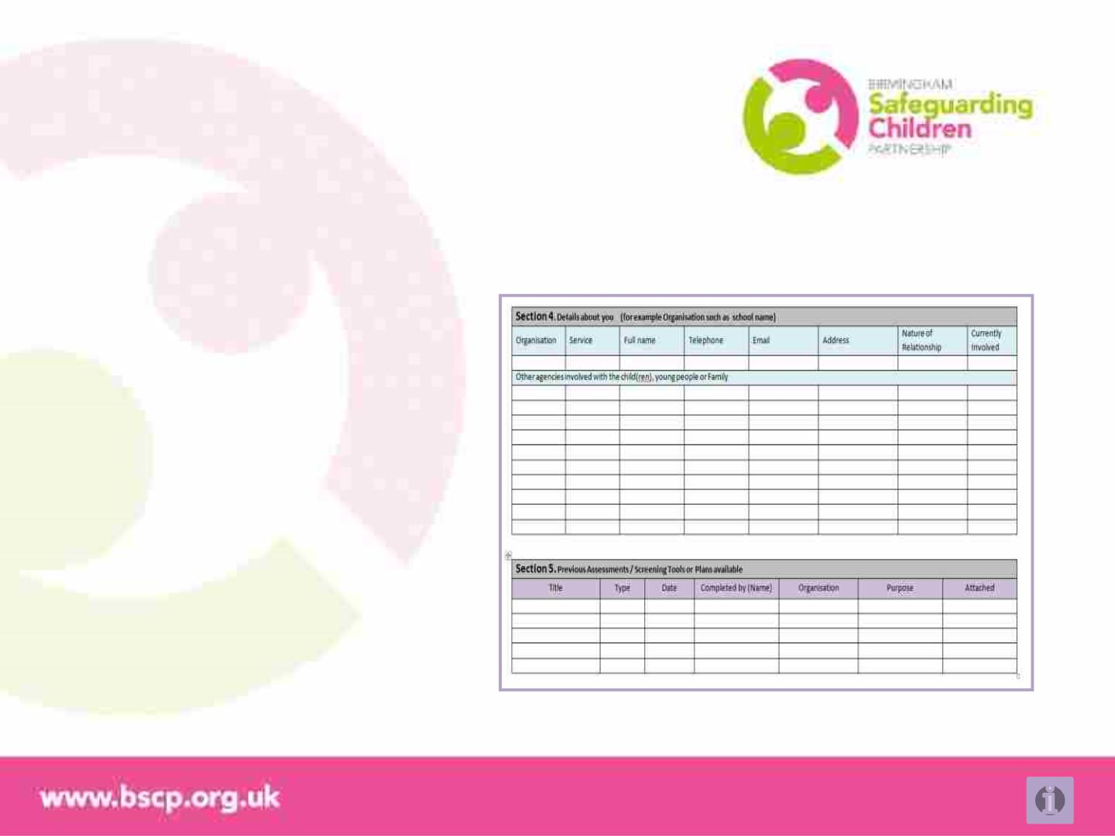
Early Help Assessment
Completing the form, section 4 & 5
Section 4
These are your details and those of other
professionals / organisations. If you are a
school, a good example might be Educational
Psychiatrists, the siblings school or a charity
supporting parents in the home
Section 5
You might have undertaken an Education and
Health Care Plan or a Child Sexual Exploitation
screening tool / assessment. Ensuring these
are known or shared is crucial to avoid the
family being repetitively assessed and becoming
fatigued but also to inform the view of the family
EHA and Plan online information

Slide 15
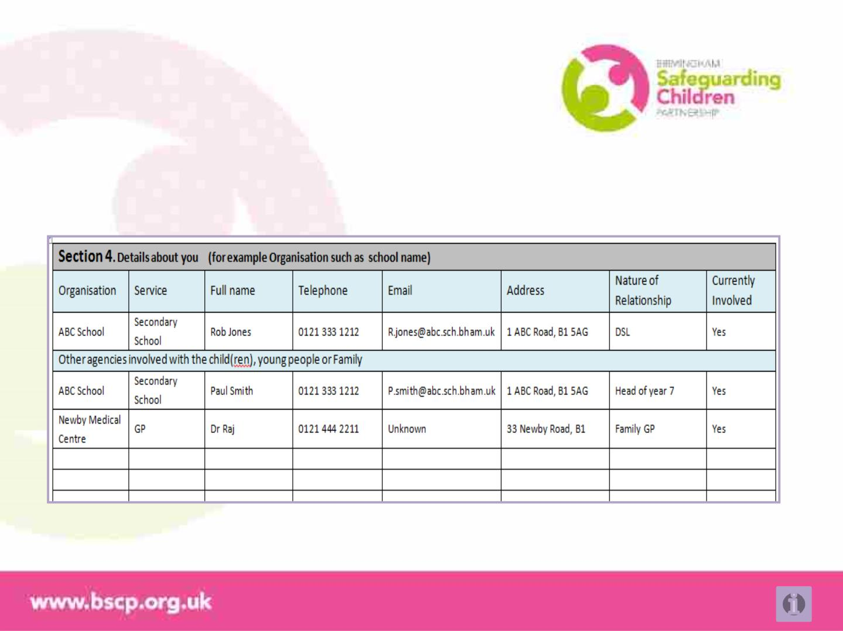
Early Help Assessment
Example of the form, section 4
EHA and Plan online information

Slide 16
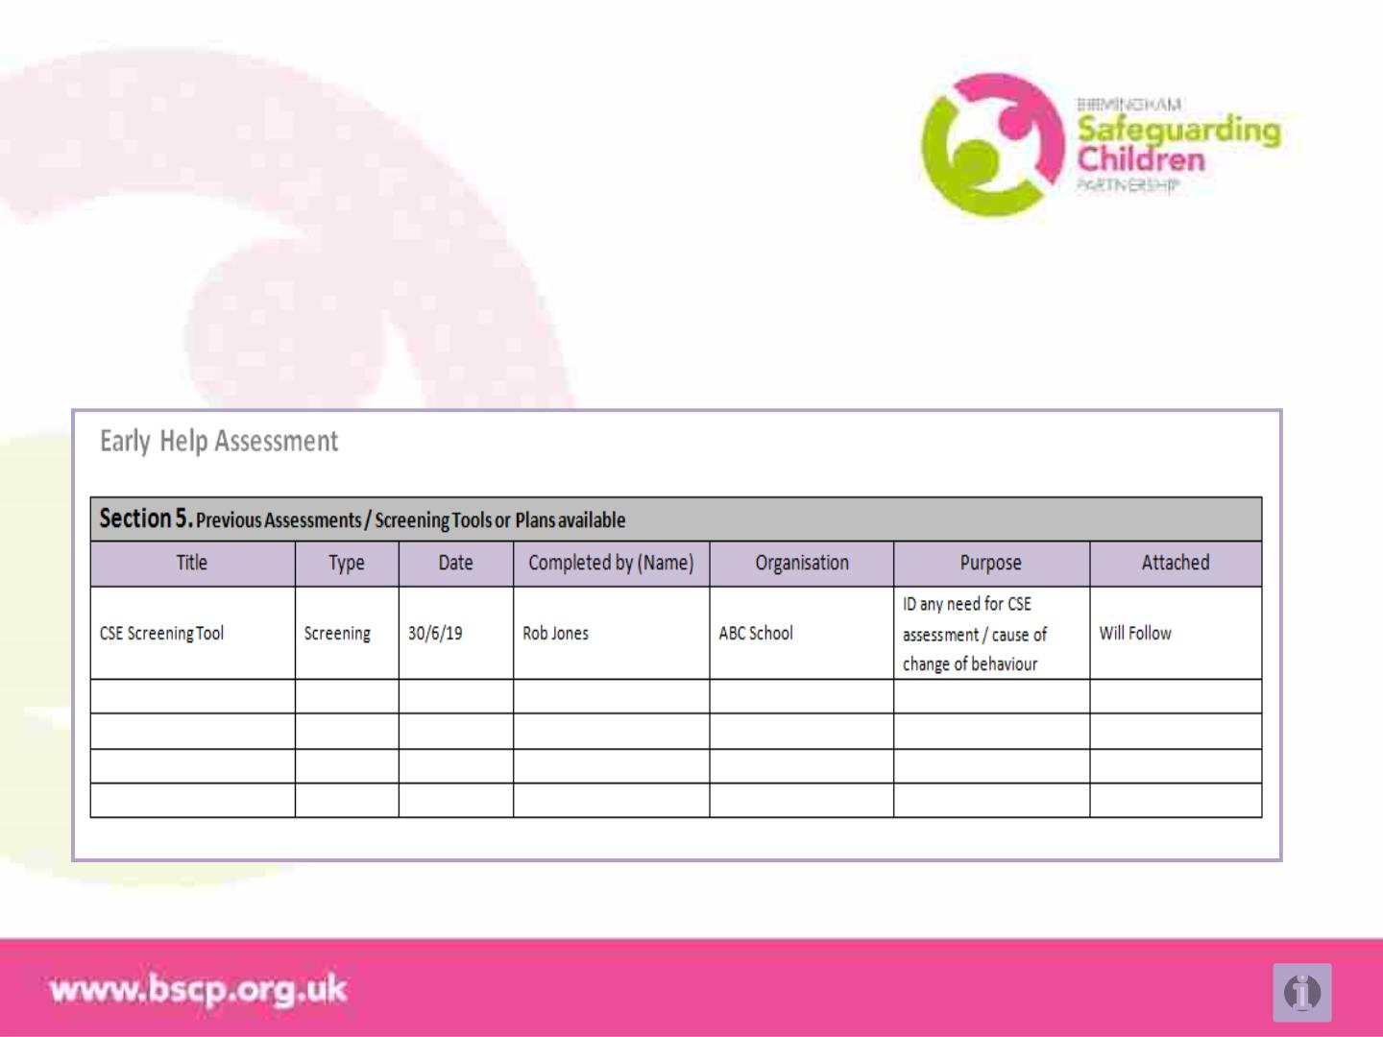
Early Help Assessment
Example of the form, section 5
EHA and Plan online information

Slide 17
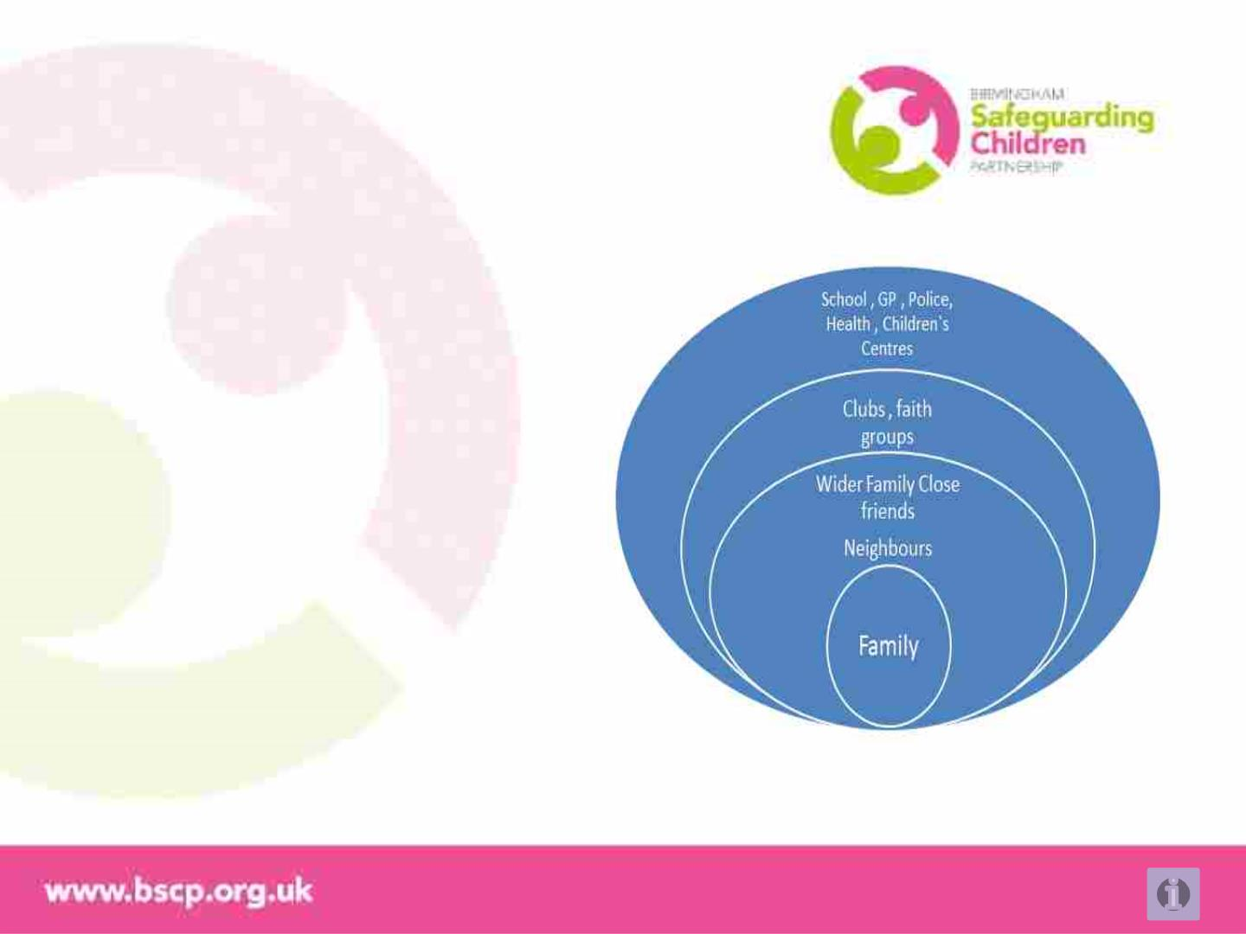
Starting the Assessment and Plan
Strength Based Conversation
A two way conversation
• Identify “What is going well,” the strengths
• Identify what is the most important
aspiration right through to what is of most
concern for individuals in the family
• Gain the voice of the children or young
people in the family, in a way that is age
appropriate
• Capture what they like to do, are able to do,
would be happy to do to help make change
EHA and Plan online information

Slide 18
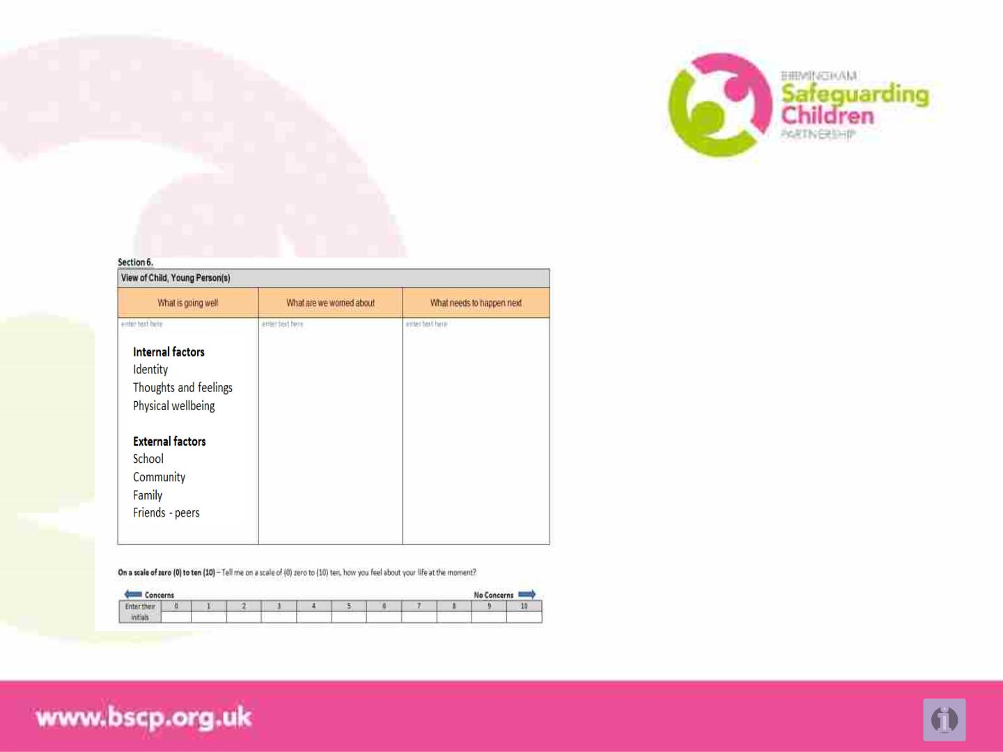
Strength Based Conversation
Early Help Assessment questions built around the Signs of Safety and Wellbeing (Three Houses)
repeated for the view of the each child / young people, parent / carer or adults and the professional
Identity
What positive qualities does a young
person see about themselves?
Thoughts and feelings
What is the young person thinking or
feeling that might positively affect their
mood or behaviour?
Physical well being
What is positively affecting the
young person`s physical wellbeing?
EHA and Plan online information

Slide 19
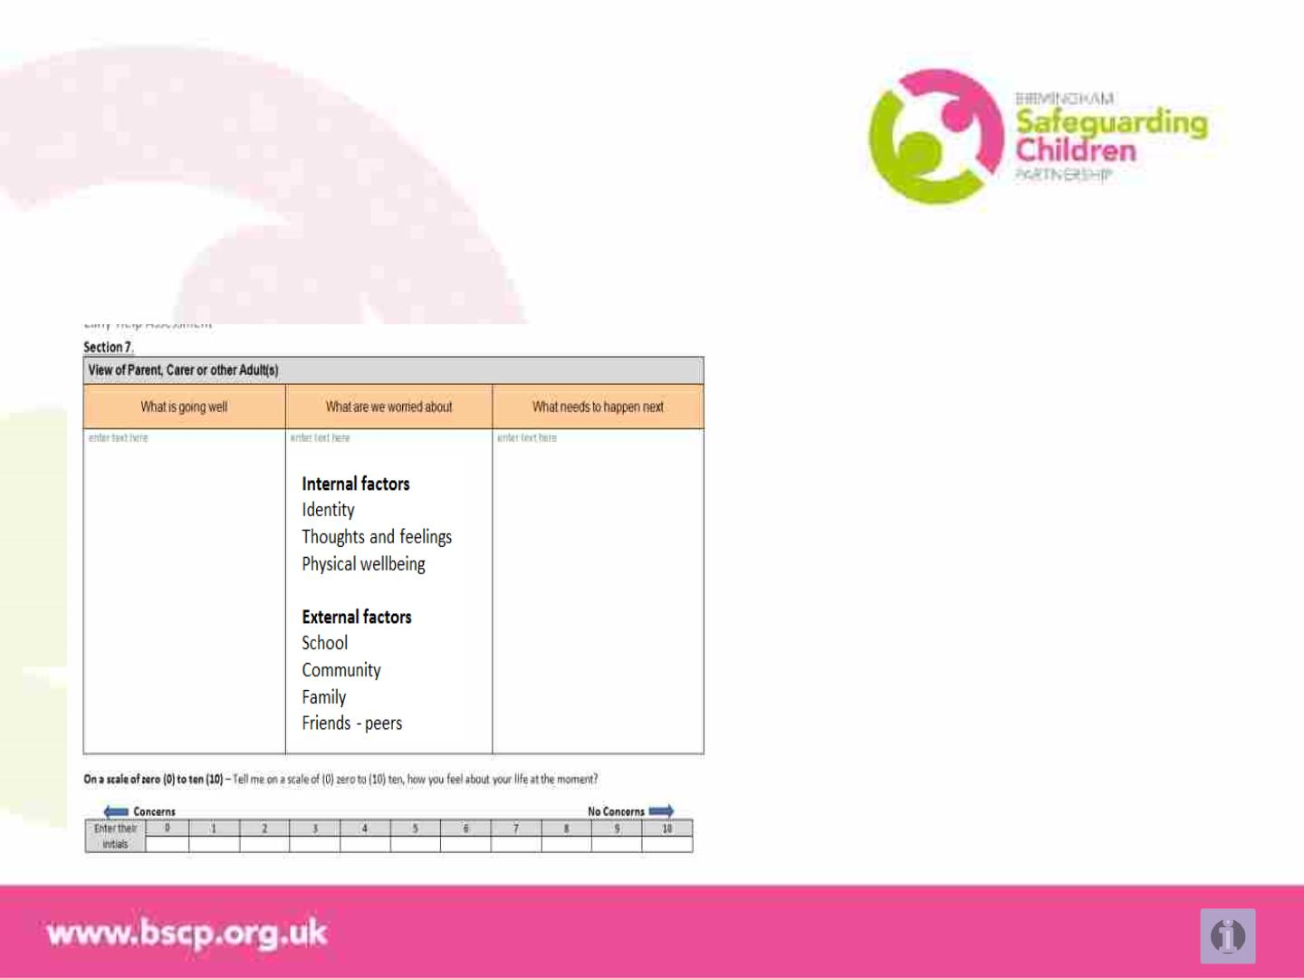
Strength Based Conversation
Early Help Assessment questions built around the Signs of Safety and Wellbeing (Three Houses)
repeated for the view of the each child / young people, parent / carer or adults and the professional
Identity
What less than positive self
perceptions does the young have?
Thoughts and feelings
What is the young person thinking or
feeling that might negatively affect their
mood or behaviour?
Physical well being
What is negatively affecting the young
person`s physical wellbeing?
EHA and Plan online information

Slide 20
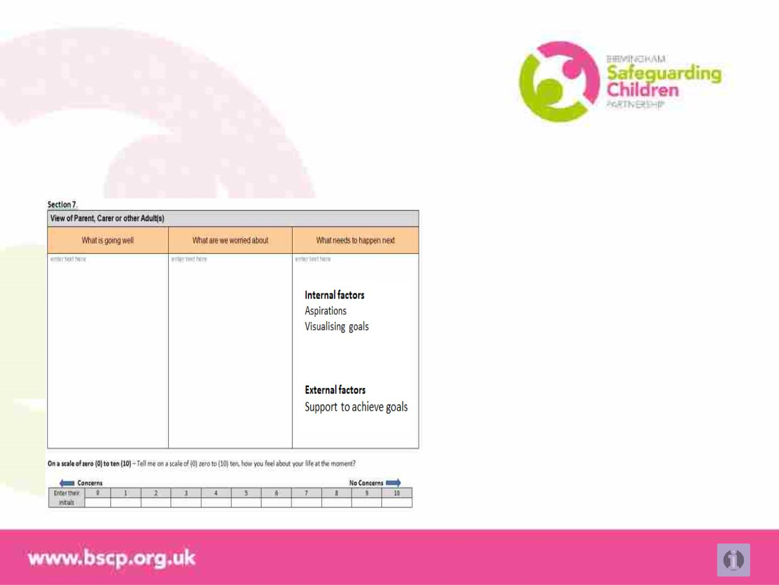
Strength Based Conversation
Early Help Assessment questions built around the Signs of Safety and Wellbeing (Three Houses)
repeated for the view of the each child / young people, parent / carer or adults and the professional
Identity
If you could wake up tomorrow and be
the best sort of person you would
really like to be, how would you feel?
Thoughts and feelings
If you could change 3 things around you
what would you change?
What help do you need to build
this house or realise this
aspiration? Who can help?
EHA and Plan online information

Slide 21
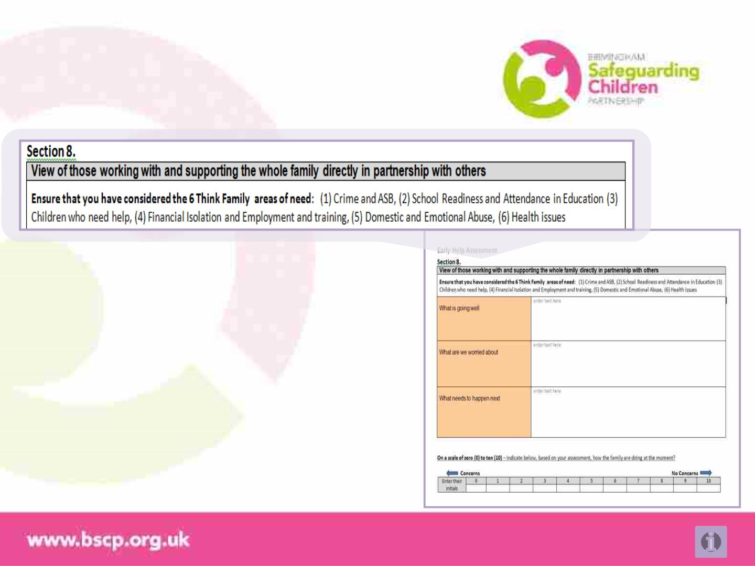
Strength Based Conversation
The three questions appear for
professionals too but the table
looks slightly different
This is designed to allow more
narrative and give space for the
six areas of need that help us
focus significant and sustained
outcomes for the family
EHA and Plan online information

Slide 22
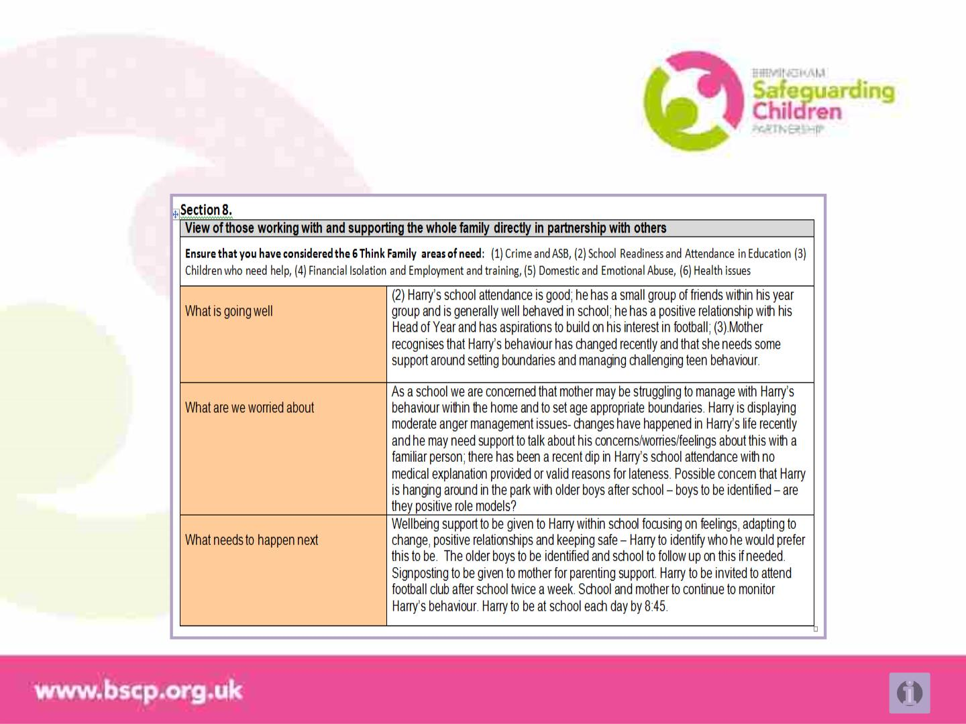
Early Help Assessment
Example of the form, section 5
EHA and Plan online information

Slide 23
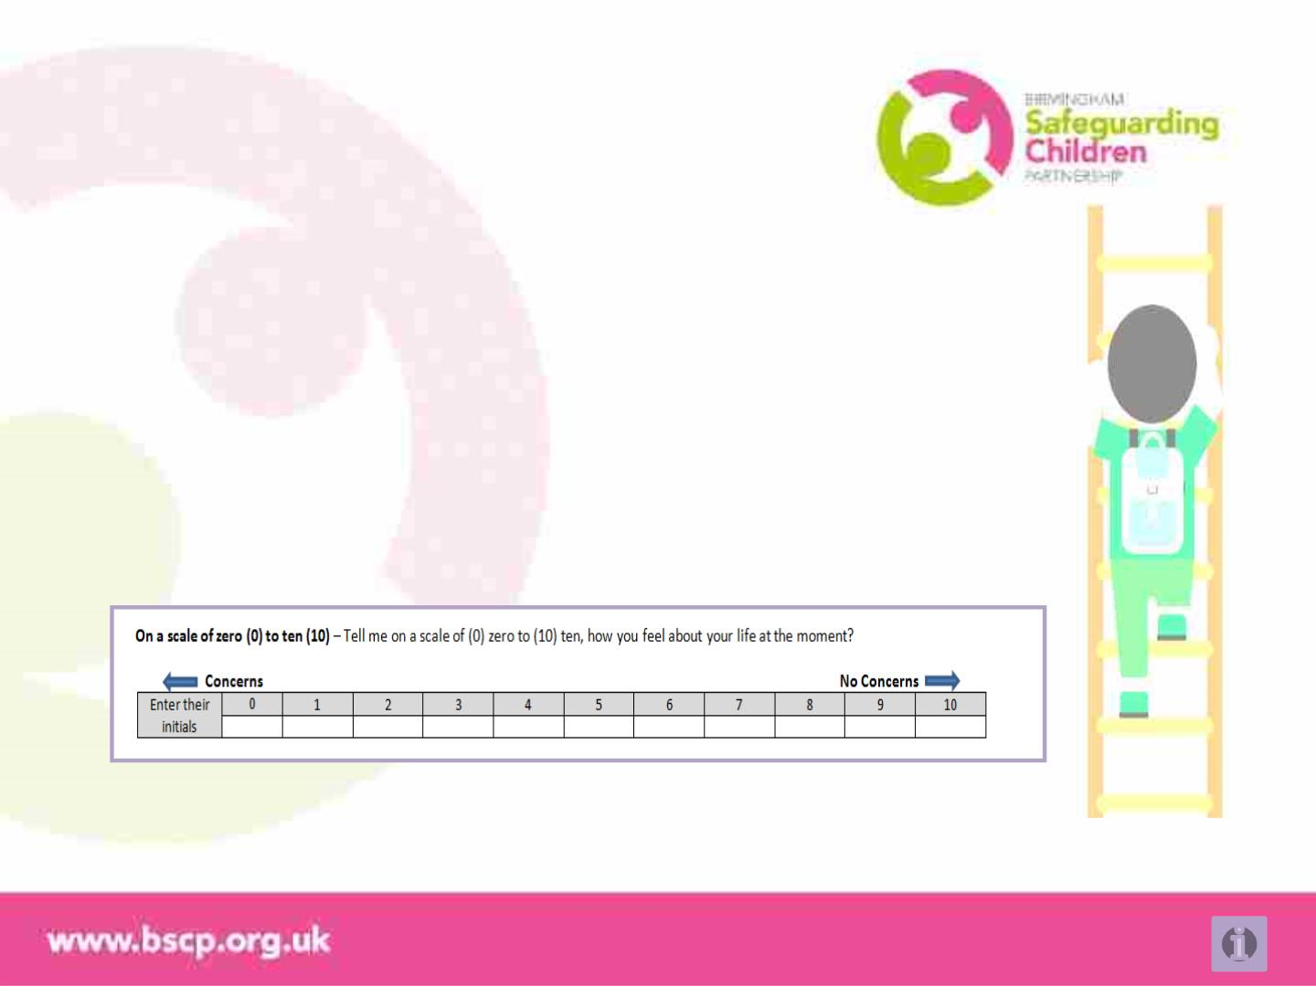
The scale
How well do we feel about things
It is important to know for each individual included in the assessment how strongly
they feel about the good things, their worries and how far life is from their aspiration
or dreams.
The scale under each persons voice does this. After discussing the answers to each
question, add the persons initials to show what each person determines for
themselves
From 0 (concerns) to 10 (no concerns)
EHA and Plan online information

Slide 24
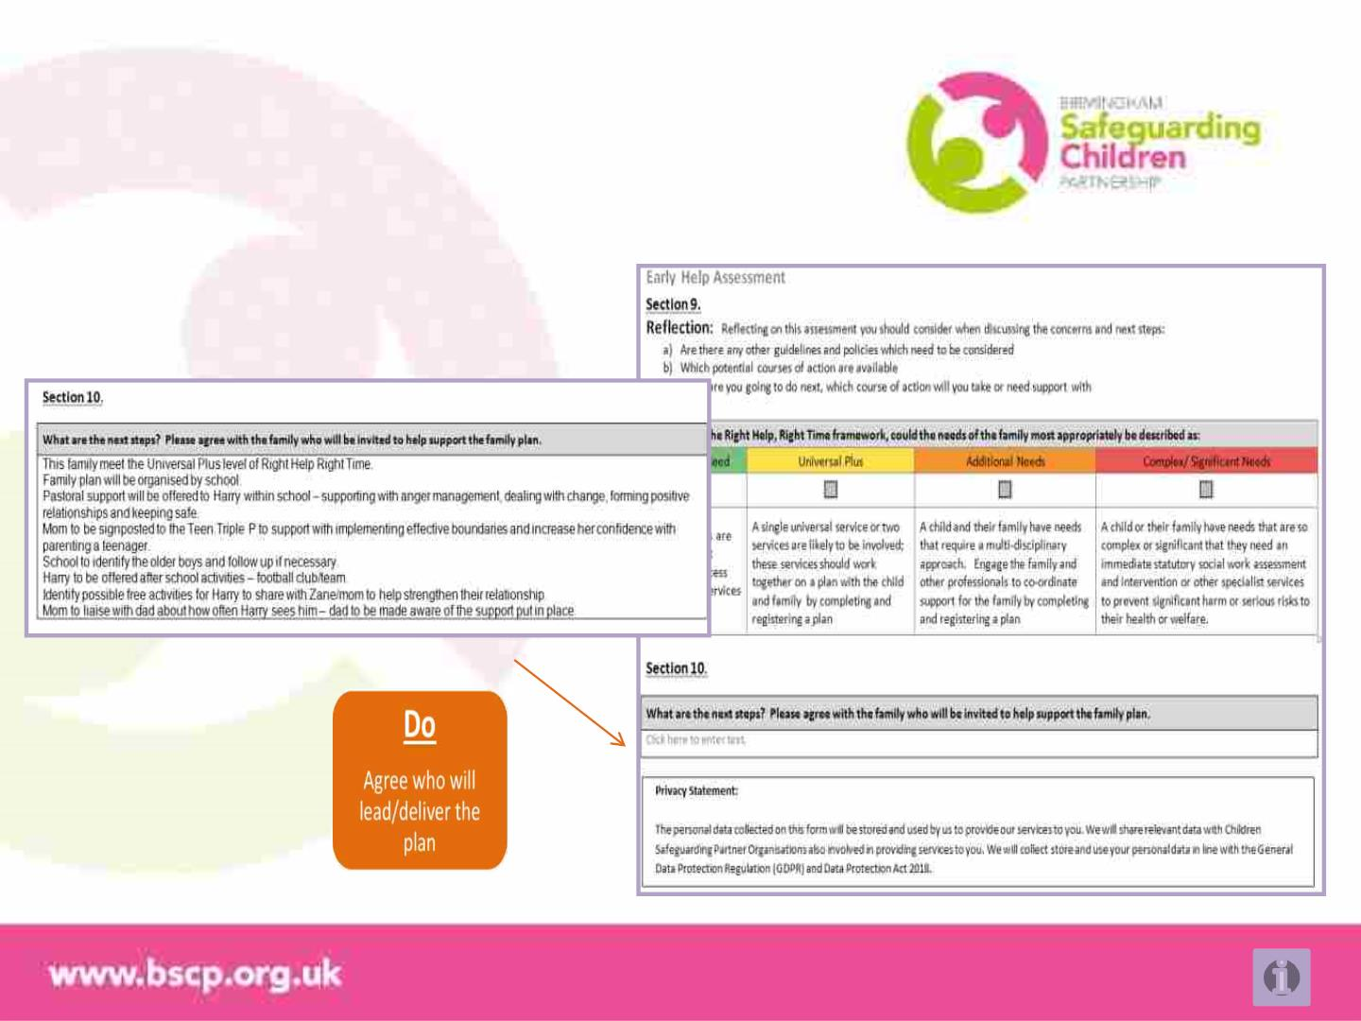
Reflecting and Doing
Go on to start an Out Family Plan?
EHA and Plan online information

Slide 25

“If you’re a working for an agency that’s involved with a
child who you suspect or believe is suffering, or is likely
to suffer significant harm, you should report your
concerns to the
Children's Advice and Support Service (CASS)
immediately”
Right Help, Right Time January 2018
Early Help Support Team
Find out if an Early Help Assessment is available and any
current Lead Professional details.
Children’s Advice and Support Service
Monday to Thursday
Friday
8:45am to 5:15pm
8:45am to 4:15pm
0121 303 1888
0121 303 8117 ehst@birminghamchildrenstrust.co.uk
Telephone
Click here for resources and guidance from the Early
Help Support Team
Emergency out-of-hours
Telephone
0121 675 4806
EHA and Plan online information

Slide 26
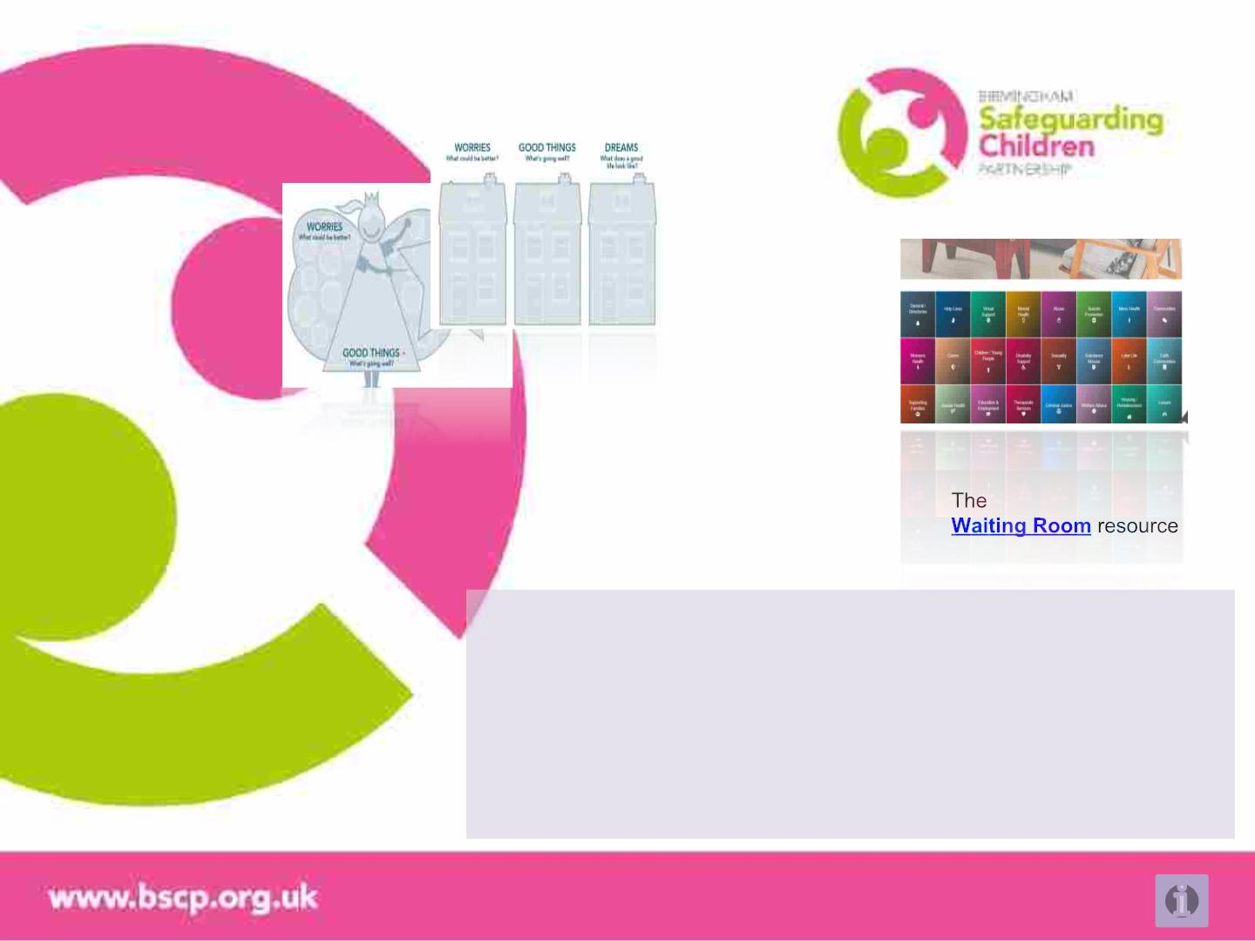
Future online tools?
http://www.lscbbirmingham.
org.uk/early-help/signs-of-
safety-and-wellbeing/toolkit
It doesn’t have to be a table the represents the questions –
Birmingham previously used houses, Manchester use a fairy and a
wizard. What would engage children, young people or adults you
work with?
You can use whatever pictorial tool – what matters is the
conversation – strength based, early in your support and that
identifies the causes of family need alongside what needs to change
EHA and Plan online information

