Slide 1
BSCP Practitioners Forum Wednesday 24th January 2024
Welcome all!
www.lscpbirmingham.org.uk

Slide 2
Programme
14.00 Welcome, Introduction and Safeguarding Update
Penny Thompson CBE, Independent Chair, Birmingham Safeguarding Children Partnership (BSCP)
14.15 Reporting Safeguarding Concerns and Requesting Support: What you need to know.
Pauline Austin, CASS Operations Team Manager
14.55 Practitioners Feedback and Questions
15.10 Learning & Development Update.
Dave Passley, L&D Programme Manager/Kerrie Dawkins, L&D Officer
Birmingham Safeguarding Children Partnership
15.25 Any other Business
15.30 Close
www.lscpbirmingham.org.uk

Slide 3
Welcome, Introduction and Safeguarding Update
Independent Chair’s Safeguarding Update:
Penny Thompson CBE, Independent Chair, BSCP • New Working Together Guidance 2023 Working together to safeguard children – Working together to safeguard children - GOV.UK (www.gov.uk)  Summary of Changes https://www.gov.uk/government/publications/working-together-to-safeguard-children--2 • Research – School exclusion reduction Glasgow & London – Published May 2023 • Domestic Abuse Commissioner’s briefs – Proposed Developments in Services for victims and survivors of domestic abuse – November 2023 • Championing Kinship Care – National Strategy – December 2023 • Improving Practice with Children Young People and Families – December 2023 • Children’s Social Care Data 7 Digital Strategy – December 2023 • BCC Budget Update letter – 01.12.2023 • WM VRU – Consultation on Reducing and Preventing School Exclusions – 08.12.2023 • Independent Chairs Blog – December 2023 • National Review – Children with disabilities and complex health needs living in residential settings – 18.12.2023
www.lscpbirmingham.org.uk

Slide 4
Reporting Safeguarding Concerns and Requesting Support: What you need to know. Pauline Austin, CASS Operations Team Manager
www.lscpbirmingham.org.uk

Slide 5
Practitioners Feedback
and Questions
www.lscpbirmingham.org.uk

Slide 6
Learning & Development Update
David Passley
Learning & Development Programme Manager, BSCP
Kerrie Dawkins
Learning & Development Officer, BSCP
www.lscpbirmingham.org.uk

Slide 7
Multi-Agency Courses – New courses have been added up to 31st March 2024
Professional Curiosity & Challenge- 23952
WEDNESDAY 14 FEBRUARY 2024 (09:15 - 16:30)
Venue: The Signing Tree (Deaf Cultural Centre) - Inside Deaf Cultural Centre Ladywood Road Birmingham
Working with Resistant Families- 23894
THURSDAY 15 FEBRUARY 2024 (09:15 - 16:30)
Venue: MS Teams
Safeguarding for Senior, Designated & Operational Managers- 23929
TUESDAY 5 MARCH 2024 (09:15 - 16.30)
FRIDAY 22 MARCH 2024 (09:15 - 16:30)
Venue: MS Teams
Safeguarding Disabled Children & Young People- 22859
TUESDAY 12 MARCH 2024 (09:30 - 16.30)
Venue: Mount Zion Community Church - 70 Thomas Street Aston, Birmingham B6 4TN
Module 1. Understanding and Responding to Coercive Control and Domestic Abuse- 23870
FRIDAY 15 MARCH 2024 (09:15 - 16.30)
Venue: Zoom
Advanced CSE - Trauma & Developing Skills for Practice- 23933
WEDNESDAY 20 MARCH 2024 (09:15 - 16.30)
Venue: The Saffron Centre - 256 Moseley Road Birmingham B12 0BS
Identifying, Supporting and Protecting Girls and Women from FGM (CPD Advanced)- 23153
WEDNESDAY 27 MARCH 2024 (10:00 - 12:30)
Graded Care Profile 2 (GCP2) Training for Practitioners
Various dates and venues available.
For Available Training Courses
Register/log in at: https://booking.lscpbirmingham.org.uk/
www.lscpbirmingham.org.uk

Slide 8
Any Other Business!
www.lscpbirmingham.org.uk

Slide 9
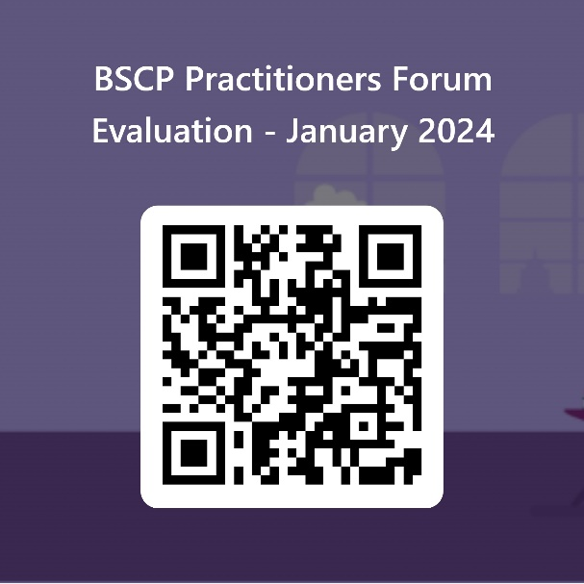
Evaluation
Your feedback is very important to us for future forums
Click Practitoners Forum - Jan 24 to access the evaluation form or use the QR code below.
www.lscpbirmingham.org.uk

Slide 10
Thank you all for attending and enjoy the rest of your day!
Next Practitioners Forum
Wednesday 20th March 2024
www.lscpbirmingham.org.uk

