Slide 1
This meeting will be recorded
www.lscpbirmingham.org.uk

Slide 2
Programme
14.00 Welcome, Introduction and Safeguarding Update
Penny Thompson CBE, Independent Chair, Birmingham Safeguarding Children Partnership (BSCP)
14.15 Safeguarding Faith Communities
Micho Moyo, Schools Safeguarding, Birmingham Childrens Trust
Junaid Akhtar, Faith Project Co-ordinator, BSCP
15.00 Learning & Development Update.
Dave Passley, L&D Programme Manager (BSCP)
Kerrie Dawkins, L&D Officer, (BSCP)
15.15 Practitioners Feedback & Any other Business
16.00 Close
www.lscpbirmingham.org.uk

Slide 3
Welcome, Introduction and Safeguarding Update
Penny Thompson CBE, Independent Chair, Birmingham Safeguarding Children Partnership (BSCP)
Independent Chair’s Safeguarding Update Today’s Executive Board – Overview of key items – 25.09.2024. Birmingham & Solihull Family Drug & Alcohol Court (FDAC) three-year report 2021-2024 – 22.07.2024 Publication of a Local Child Safeguarding Practice Review & webinar - BSCP2019-20/01: ‘Never Assume’ - 23.07.2024 Childrens Commissioner: Strip Searching of Children in England & Wales – August 2024 BSCP Summer Newsletter – 08.08.2024 Publication of a Local Child Safeguarding Practice Review & webinar- BSCP2021-22/01: ‘Out of Sight’ - 03.09.2024 Safeguarding Leaders Assembly: Focusing on Serious Youth Violence and Child Exploitation – 07.11.2024
www.lscpbirmingham.org.uk

Slide 4
Safeguarding in Faith Communities Project
Micho Moyo
Schools Safeguarding, Birmingham Childrens Trust
Junaid Akhtar
Faith Project Co-ordinator, BSCP
www.lscpbirmingham.org.uk

Slide 5
Learning & Development Update
David Passley
Learning & Development Programme Manager, BSCP
Kerrie Dawkins
Learning & Development Officer, BSCP
www.lscpbirmingham.org.uk

Slide 6
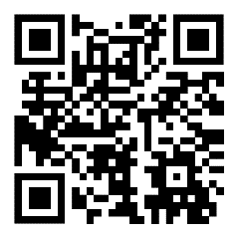
Courses Available throughout October/November (with limited spaces available)
NSPCC Graded Care Profile 2 (GCP2) training for practitioners
Wednesday 9 October 2024 (09:30 - 16:30)
Child Exploitation: Tackling CE Together in Birmingham
Monday 21 October 2024 (09:15 - 16.30)
Working with Resistant Families
Thursday 7 November 2024 (09:15 - 16:30)
NSPCC Graded Care Profile 2 (GCP2) training for practitioners
Thursday 14 November 2024 (09:30 - 16.30)
Safeguarding Disabled Children & Young People
Thursday 21 November 2024 (09:30 - 16:30)
Child Exploitation: Tackling CE Together in Birmingham
Thursday 21 November 2024 (09:15 - 16.30)
NSPCC Graded Care Profile 2 (GCP2) training for practitioners
Tuesday 26 November 2024 (09.30 - 16.30)
Safeguarding for Senior, Designated & Operational Managers
Tuesday 26 November 2024 (09:15 - 16.30)
To Register and book, go to https://booking.lscpbirmingham.org.uk/login or use the QR code on the right.
To book, scan the QR code or go to: Multi-Agency Training - Birmingham Safeguarding Children Partnership (lscpbirmingham.org.uk)
www.lscpbirmingham.org.uk

Slide 7
Practitioners Feedback
and Questions
www.lscpbirmingham.org.uk

Slide 8
Any Other Business!
www.lscpbirmingham.org.uk

Slide 9
Evaluation
Your feedback is very important to us for future forums
Click https://forms.office.com/e/Zex4Tp0zVi to access the evaluation form or scan the QR code below.
Please submit your response by 4th October 2024
www.lscpbirmingham.org.uk

Slide 10
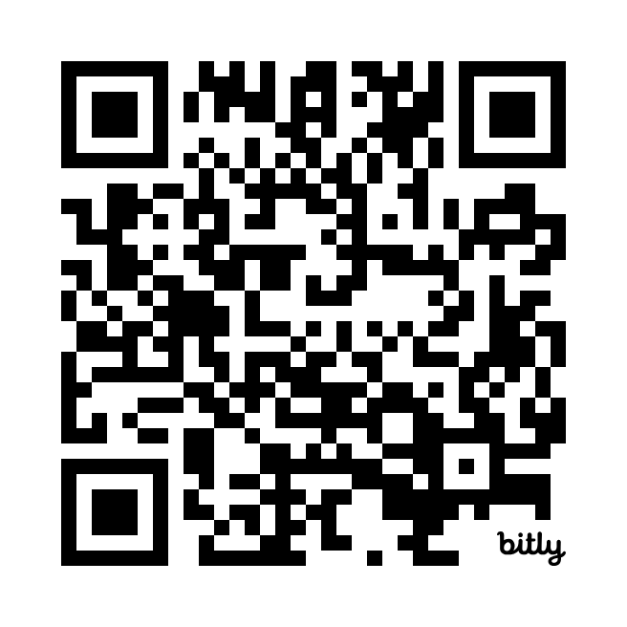
Safeguarding News Partnership Updates Training Opportunities

Slide 11
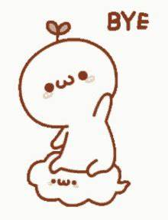
Thank you all for attending and enjoy the rest of your day!
Next Practitioners Forum
Wednesday 4th December 2024
www.lscpbirmingham.org.uk

