Slide 1
Safeguarding Leaders’ Assembly
Thursday 23rd November
The MAC, Birmingham
www.lscpbirmingham.org.uk @BirminghamLSCP

Slide 2
This Morning’s Agenda
9:15 | Independent Chair’s Introduction
9:30 | Birmingham Domestic Abuse Prevention Strategy 2024 -2029 - Consultation Close 6th December 2023
9:50 | Safeguarding ‘Children out of sight’
10:30 | Comfort Break
10:45 | Facilitated Workshop & Plenary Session
11:45 | Any Other Business
12:00 | Close
www.lscpbirmingham.org.uk @BirminghamLSCP

Slide 3
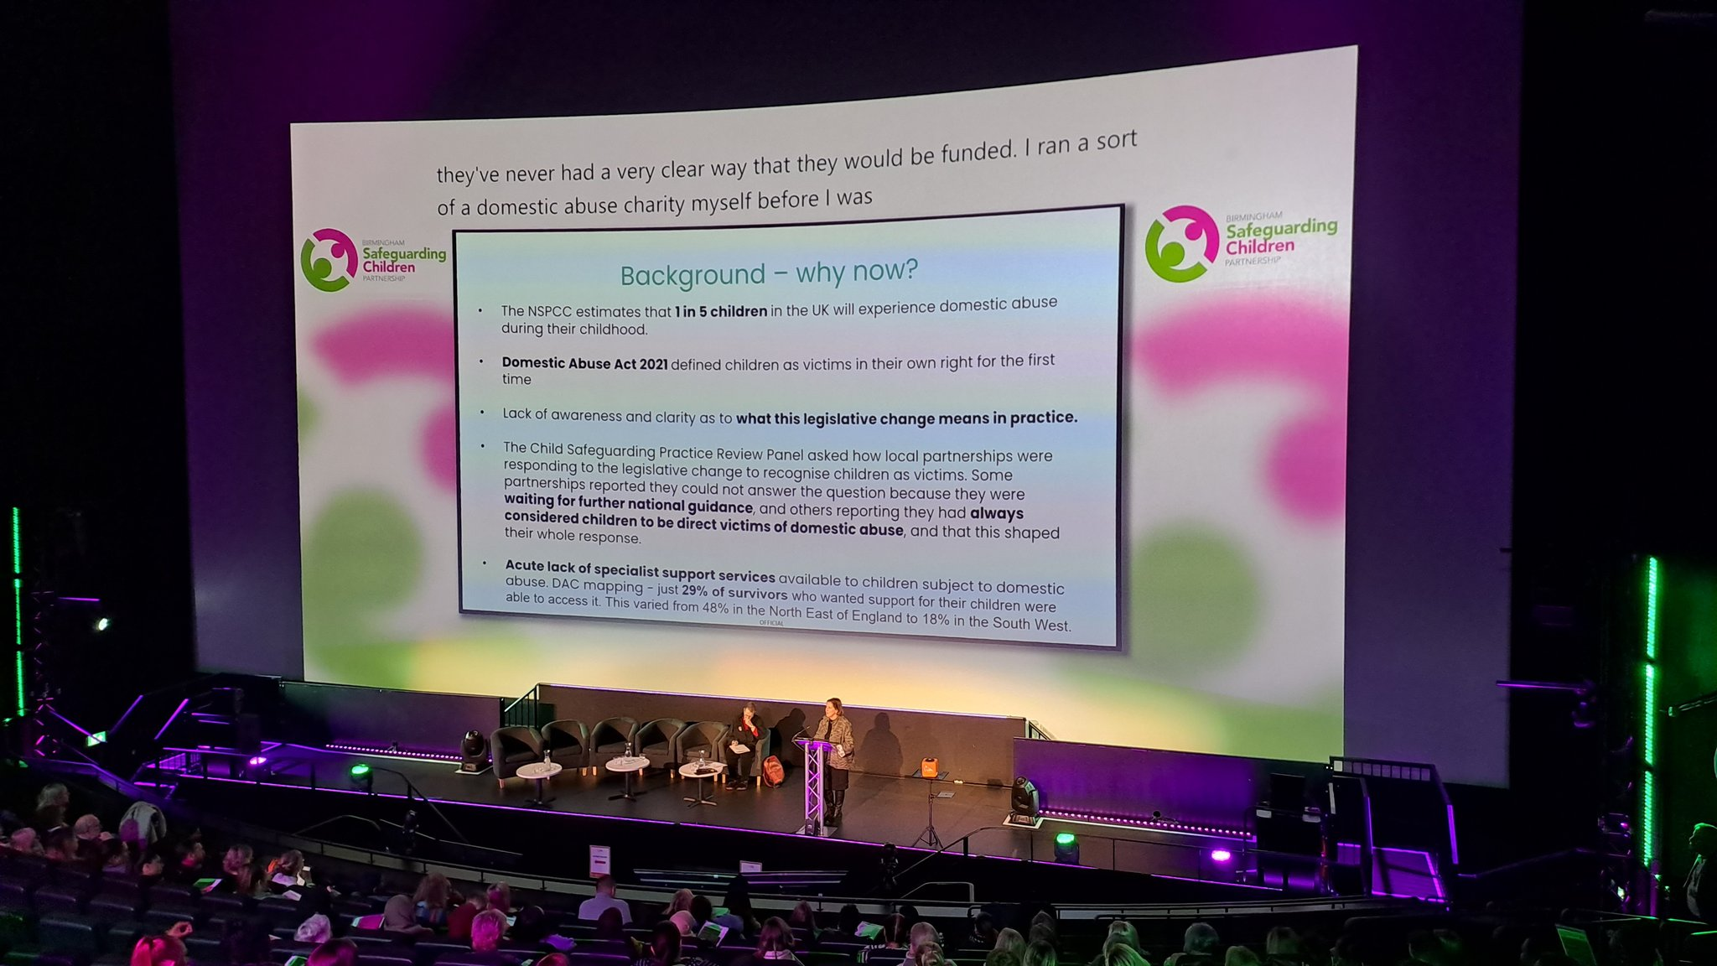
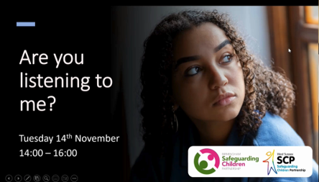
Independent Chair’s Introduction & Safeguarding Update
Safeguarding Leaders’ Assembly - Summary 27.04.23
Contextual Safeguarding Board- Tackling Exploitation of Children and Young People Strategy 2023-2026 – Launched – September 2023
Safeguarding Newsletter – Autumn 2023
Publication of Child A – 10.10.2023
System leader’s Workshop: Strengthening Safety with Young People, Families and Communities – 13.10.2023
National Panel - Regional Round Table – 09.11.2023
‘Are you Listening to me?’ Webinar – 14.11.2023
Birmingham City Partnership – 15.11.2023
‘Working as Partners to Safeguard Children from Domestic Abuse’ Conference – 16.11.2023
Serious Youth Violence - Recent High-Profile Cases – November 2023
Coming soon - Independent Chairs’ Blog
Launch of online Request for Support Form – & video guidance - 29.11.2023
www.lscpbirmingham.org.uk @BirminghamLSCP

Slide 4
Birmingham Domestic Abuse Prevention Strategy 2024+
Graham Tilby
Birmingham Children’s Trust
www.lscpbirmingham.org.uk @BirminghamLSCP

Slide 5
Birmingham’s Draft Domestic Abuse Prevention Strategy 2024+
Context:
Domestic abuse (DA) is a hidden crime which impacts every part of a victim’s life, from their finances and their ability to work, to who they can see, to their basic right to live their lives without fear.
Nationally: –1st April 2021 – 31st March 22- 2.4 million adults experienced DA related crime(CSEW).
Locally- DA drives demand across the city:
In 2022/23 domestic abuse was the 3rd top reason homeless presentations
In 2022, it was the 2nd highest reason for contacting BCT
DA crimes reported to the police have more than doubled in from 13,664 in 2018/19 to 27,770 in 2022/23.
This data is the tip of the iceberg – most domestic abuse is not reported
Draft Domestic Abuse Prevention Strategy 2024+:
Builds on the previous strategy and its proactive prevention model by embedding this approach throughout, to prevent DA from occurring in the first place through raising awareness and understanding of it , and to also intervene earlier to prevent escalation of risk.
Partnership strategy- written collectively, renamed “Birmingham’s Domestic Abuse Prevention Strategy” recognition no one single agency can tackle it.
Whole system approach- recognising network of agencies that provide support and how work together.
.

Slide 6
What is the scope of the draft strategy?
Domestic abuse can happen to anyone, from any background, in any relationship. This strategy aims to support everyone who experiences domestic abuse.
Although anyone can be subject to domestic abuse, it is a crime that mainly affects women so our strategy takes a gendered approach. The national government’s ‘Tackling Violence Against Women and Girls’ strategy, and our local Needs Assessment have both emphasised the importance of recognising the gendered nature of domestic abuse. In Birmingham:
Of the 2.4 million adults who reported domestic abuse related crime in England and Wales between 1st April 2021 – 31st March 2022, 74.1% were female (Crime Survey England and Wales)
In Birmingham, of the 27,770 domestic abuse crimes reported to police, between 1st April 2022 – 31st March 2023, 74% were women (West Midlands Police Data)
Of the 992 domestic abuse homeless presentations in Birmingham 2022/23, 943 were women (Birmingham City Council data).
The draft strategy recognises that survivors from diverse communities face additional barriers to support and reporting. We aim to get rid of these barriers, and meet intersectional needs to make sure everyone can access the support they need.
.
Notes:
Note to presenters: - it is important that the whole consultation is not taken up by this issue. Present the information available, make clear that in Birmingham we commission both accommodation and lead worker support for male victims, and if people want to take this issue up further they can email the DA team at the inbox at the end.

Slide 7
Strategy working group : work to date
A strategy working group, made up of key partners, was set up to draft the new strategy, building on the previous Domestic Abuse Prevention strategy”.
Key values and principles adopted include:
importance of trauma informed and trained workforce; Gendered approach, embedding equalities and intersectionality to support our super diverse city; Whole system response
Being survivor-centred in our approach throughout the strategy
Embedding prevention and early identification, including prevention of escalation of risk.
The group reached out to get views from survivors asking them what they need in the city. They did this by with specialist providers who held workshops in their services with survivors. There was also a wider survey aimed at survivors not in services.
Workshops and meetings have also been taking place with key agencies, to create the vision, values, and priorities for the strategy.

Slide 8
Our Vision , Values and Priorities for change
Vision: “Birmingham is a place where domestic abuse is not tolerated; where everyone can expect equality and respect in their relationships, and live free from domestic abuse.“ Values:
Survivor-centred and survivor-led | Early intervention and prevention
Strengths-based approach | Intersectionality
Perpetrator accountability | Robust partnership response
Priority 1
Priority 2
Priority 3
Priority 4
Priority 5
Priority 6
Whole Systems Approach
Making DA everybody's business.
All partners working collectively and collaboratively as a network, to respond to and prevent DA. Recognising DA complexity and intersectionality, and integral role each partner plays in the system.
Prevention-Changing Attitudes and behaviours
Culture change, through awareness raising , with the aim: -Challenging attitudes that foster DA.
-Understanding that DA is solely the fault of the perpetrator.
Ensuring needs of marginalised survivors are highlighted in this.
Prevention - Early identification and help
Focus on early identification of the signs of abuse. Strengthening confidence and first responses from all professionals to prevent escalation of risk and harm and provide tailored support to survivors.
Embedding an early help offer of DA in the universal space e.g., family hubs.,gp’s
Children and young people are protected
Raising awareness & understanding Healthy relationships.
Identify and support children and young people affected by domestic abuse, including supporting young people in abusive relationships, as well as abuse from family.
Safety Support and Recovery
Keeping survivors and their children safe is paramount concern.
Commissioning quality assured support to survivors in safe accommodation as per Part 4 DA Act duty.
Developing a longer term and holistic offer to aid recovery.
Hold perpetrators to account
Develop an intervention pathway that sets out a range of actions that holds perpetrators to account, at every opportunity across the system, whilst ensuring that survivors are protected from harm.
Notes:
Values:
Survivor centred and survivor led-Tailored, trauma-informed support to survivors including children (child centred), recognising safety as paramount, going at her pace throughout.
Strengths-based - Recognise all the survivor has done to keep herself and children safe, she is the expert and is no way to blame for perpetrator's behaviour.
Early Intervention and Prevention - Preventing abuse happening in the first place & preventing the escalation of risk.
Accountability - Recognise all actions perpetrator takes to abuse including using children to control, post separation abuse and hold them accountable.
Intersectionality - Remove barriers to support for marginalised communities, actively adopt anti-racist practice and consider intersecting needs like mental health or substance addiction.
Robust partnership response - Whole systems response to domestic abuse with strong and simple pathways to quality assured support services, ensuring the right support at the right time from all professionals.

Slide 9
Priority 1 – Whole System: Leadership, Partnership & Workforce
In line with the Domestic Abuse Act we have established a Domestic Abuse Strategic Board who will lead and drive forward progress made against the key priorities and ensure robust communication links with other strategic groups. It will deliver a co-produced, robust, co-ordinated community response to domestic abuse across the strategic partnerships and plan effective use of resources to improve outcomes.
Those subjected to domestic abuse, predominantly women and children, interact with multiple professionals in their day-to-day lives. This network of agencies across the city creates the whole system, and requires a consistent, coordinated response to domestic abuse.
What we will do:
Conduct multi-agency reviews to consider the qualitative impact of progress made against the key priorities and the difference that this has made to the lives of survivors and their children.
Ensure lessons learnt from Domestic Homicide Reviews, child and adult Serious case reviews (which include aspects of domestic abuse) are shared with organisations and are jointly considered at senior partnership level and learning is cascaded throughout the partnership.
Develop a consistent, systematic process for collecting and sharing domestic abuse data and insight across the partnership to inform our strategic direction and action plan. This will also assist in understanding of demand, diverse characteristics and unmet need and used to inform service developments, future commissioning intentions and aim to remove any identified barrier to accessing support.
What success will look like:
Survivors across the system are given the right support at the right time, wherever they are, by a more confident and trained trauma-informed workforce, using a shared language and No Wrong Door approach.

Slide 10
Priority 2 Prevention- Changing attitudes and behaviours.
Culture change across the city using awareness raising, understanding and education, with the aim challenging attitudes that foster domestic abuse. Challenging victim-blaming attitudes by increasing understanding across the city that domestic abuse is solely the fault of the perpetrator.
What we will do:
Develop and implement a comprehensive partnership communication and marketing strategy to raise the profile and awareness of domestic abuse throughout the year, through different mediums: campaigns, toolkits, social media, digital media, ensuring consistent and appropriate communication messages around domestic abuse.
Changing attitudes of key partners in the system, from leadership to frontline officers – not victim blaming, embedding anti racist practice, challenging misogyny and holding perpetrators to account.
Encourage all employers in the city to adopt domestic abuse workplace policies that include support for employees who are survivors, and a no tolerance policy for perpetrators of domestic abuse.
What success will look like:
An increase in healthy relationships, and a decrease in victim blaming attitudes and tolerance for abuse.

Slide 11
Priority 3 Prevention- Early identification and Help
Clear focus on early identification of the signs of abuse and strengthening first responses from all professionals to prevent escalation of risk and harm. Embedding an early help offer of domestic abuse in the universal space like family hubs and health settings.
What we will do
Embed professional curiosity, for example through routine enquiry, to empower staff to recognise signs of domestic abuse at an early stage, and offer appropriate, tailored support.
Embed an approach that ensures that risk assessment and safety planning is an ongoing process and part of every interaction with the survivor, to help prevent the escalation of risk, recognising that risk can change daily.
Increase the public awareness so that those experiencing abuse will be better able to identify what they are experiencing and know how to access support sooner.
What success will look like:
Domestic abuse will be identified earlier, survivors receive the right support at the right time, and escalation and harm is prevented.

Slide 12
Priority 4 - Children and young people are protected from the effects of domestic abuse
Work as a partnership to Identify and support children and young people affected by domestic abuse, including supporting young people in abusive relationships.
What we will do
Raise awareness and understanding of what to expect from a relationship, based on equality and respect, reviewing the current offer in all settings including schools, colleges, universities, and working to ensure a consistent offer to young people.
Ensure there is specialist children’s support across the pathway, from prevention through to crisis
Ensuring that all services are supportive of the non-abusive parent and recognise all of the actions they take to keep their child safe, whilst recognising that an abusive parent cannot be a good parent.
What success will look like:
Children and young people across the pathway understand healthy relationships, and access appropriate support where needed.

Slide 13
Priority 5 –Safety, Support and Recovery Priority 5 - Safety, Support and Recovery prio
Ensuring that survivors and their children are kept safe and are supported through good quality assured specialist support both in safe accommodation as per Part 4 DA Act duty and in a community setting. Develop and embed a longer-term holistic offer to recovery
What we will do
Commission quality assured specialist support for survivors and their children in safe accommodation, that meets their complex needs, based on needs assessment, data insight and intelligence from the market, including specialist DA sector to inform our commissioning intentions.
Increase the amount of community support, and awareness of mechanisms such as civil orders and Sanctuary, available to enable survivors to stay safely in their own homes surrounded by their own support networks, where it is safe to do so.
Ensure that holistic support to recover following the abuse is given, recognising wider needs such as mental health or financial support, and that professionals understand risks around post-separation abuse and suicide.
What success will look like:
Increasing the number of survivors and their children who feel they can live their lives safely, and continue to live freely following the abuse.

Slide 14
Priority 6 - Hold perpetrators to account Priority 6 - Hold perpetrators to account
Develop an intervention pathway that sets out a range of actions that holds perpetrators to account at every opportunity across the system rather than rely on a single agency to do this, and without putting the burden of actions on the survivor. This should span the continuum of domestic abuse ranging from civil injunctions and DAPO’S, to criminal convictions and offender management.
What we will do
Develop a shared vision, where all partners recognise the need to work more collaboratively to hold perpetrators to account for their behaviour. Using learning from DHR’S and child and adult serious case reviews.
Ensure partners continue to share appropriate information regarding risk of perpetrators – to work to keep survivors and her children safe.
Empower frontline staff through specialist training and good practice guidance to implement interventions for the perpetrator (e.g. Civil orders), and challenge the abusive actions that perpetrators commit, recognising the impact of the actions and behaviour and understand that domestic abuse is a choice, and not a result of e.g., substance addiction or mental health. All perpetrator intervention must keep the safety of women and children at the forefront.
What success will look like:
Survivors and their children are safe from the perpetrator, and all interventions across the system include perpetrator.

Slide 15
What does success look like?
This strategy seeks to achieve the following outcomes:
Survivors and their children are offered survivor centred support to address their specific needs.
Workforce are confident to recognise and respond to domestic abuse through trauma informed training.
Our community is educated as to what domestic abuse is, and what services are available in Birmingham.
Abuse is reported earlier as people are confident in raising the issue, therefore reducing opportunities for harm.
Consistent whole system approach is in place to respond appropriately to domestic abuse wherever the survivor is on their journey.

Slide 16
Question 1 The vision is taken from the existing strategy. Is the vision, value and principles reflective of the City’s ambition? If not, what should this be?
Vision
“Birmingham is a place where domestic abuse is not tolerated; where everyone can expect equality and respect in their relationships, and live free from domestic abuse. “
Values and principles
Survivor centred -Tailored, trauma-informed support to survivors including children (child centred), recognising safety as paramount.
Strengths-based - Recognise all the survivor has done to keep herself and children safe, she is the expert and is no way to blame for perpetrator's behaviour.
Early Intervention and Prevention - Preventing abuse happening in the first place & preventing the escalation of risk.
Accountability - Recognise all actions perpetrator takes to abuse including using children to control, post separation abuse and hold them accountable.
Intersectionality - Remove barriers to support for marginalised communities, actively adopt anti-racist practice and consider intersecting needs like mental health or substance addiction.
Robust partnership response - Whole systems response to domestic abuse with strong and simple pathways to quality assured support services, ensuring the right support at the right time from all professionals.

Slide 17
Question 2 a) Do the priorities reflect the key issues/challenges in Birmingham? b) If not, what is missing? c) Do they reflect your organisational priorities on DA?

Slide 18
Question 3 a) Each priority will have a focus. What do you think the focus should be under each one?

Slide 19
Wider consultation
This draft was created based on a series of workshops and conversations with key agencies in the city and survivors.
This wider consultation began 25th October 2023, and runs for 6 weeks until 6th December 2023.
There are a number of ways during this time that we are getting views:
Be Heard survey
Workshops with specialist services
Workshops with survivors, carried out by specialist services
Conferences, e.g. Cost of Living Week conference, and Safeguarding Children conference
.

Slide 20
Next steps
We need you to take the consultation to your citizen and partnership groups during the period with the citizen slides available, and signpost to survey
All feedback given on the strategy is collected by Birmingham’s Domestic abuse team
This feedback will be looked at and used to shape the next version of the strategy
We are also working with agencies on an action plan that will deliver the strategy
A final strategy will be presented to elected members in Council for approval next year
Following approval, the final strategy will be launched in Spring 2024
.

Slide 21
If you would like to feed back further
Email DAteam@birmingham.gov.uk
Link to Be Heard

Slide 22
Children Out of Sight
Di Rhoden, Director of Nursing – Safeguarding, Children in Care &CDR, BSOL ICB
Razia Butt, Director for Thriving Children and Families, Birmingham City Council
Claire Capewell, Associate Director of Safeguarding, Birmingham Community Healthcare NHS Trust
www.lscpbirmingham.org.uk @BirminghamLSCP

Slide 23
Out of Sight Group
Number of cases of concern through safeguarding of children missing / out of sight
Agreed group to be convened from QIO – subgroup of BSCP
Initial priority – identify where children may be lost from sight, to review children out of sight to universal services
Identify gaps in handovers between universal services
Audit cases to identify learning
Ensure lived experience of children and families is being considered when children are removed from universal services such as education
Develop performance data, identifying key priorities
www.lscpbirmingham.org.uk @BirminghamLSCP

Slide 24
Out of Sight – Initial Work
Review of the work of education – assurance
Early years – Primary schools
Primary schools – secondary school
Secondary school – post 16
Part –time timetables
Low-school attendance
Health
Maternity – HV
HV – SN
GP – ghost children
Children not bought to appointments – but also not in school, ? Increased risk
Police – review of identified inactive missing children
Boarder Force – children in / out of the country
www.lscpbirmingham.org.uk @BirminghamLSCP

Slide 25
Out of sight – Further Work
Facilitated workshop – joint responses during COVID
Use of systems already know to work well – CASS
BSCP – Leaders assembly – way forward agreed
www.lscpbirmingham.org.uk @BirminghamLSCP

Slide 26
Children missing education and out of sight
EHCP/SEND
Exclusions
Part-time timetables
Elective Home Education
Poor attendance
No school place
Newly arrived, new to area
Insecure immigration status
Private fostering arrangements
Transient groups
Unregulated provision
Temporary Accommodation
Families living ‘off-grid’
No take up of EEE
Risk of serious youth violence
At risk of exploitation
Abroad and out of contact
Never been known to services
www.lscpbirmingham.org.uk @BirminghamLSCP

Slide 27
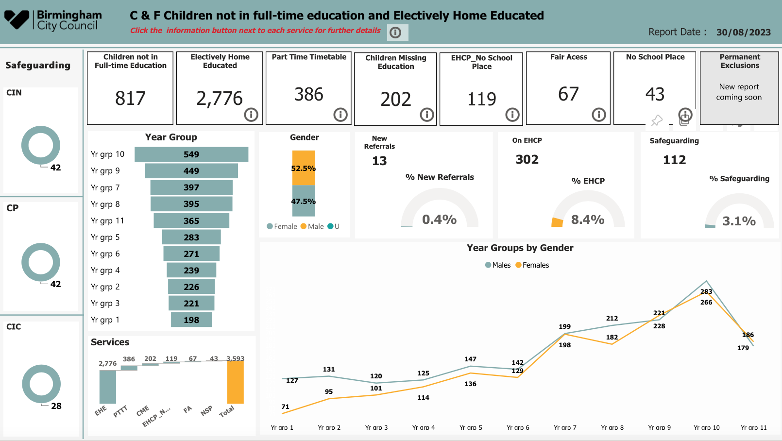
Razia
www.lscpbirmingham.org.uk @BirminghamLSCP

Slide 28
Reasons for children being out of sight of services
Ideological or philosophical views, or different education to that provided in schools
Religious or cultural beliefs
Dissatisfaction with the school system
Bullying of the child at school
Health reasons
School phobia
Special educational needs
Dispute with school
Awaiting a school place
Familial reasons
Exploitation
www.lscpbirmingham.org.uk @BirminghamLSCP

Slide 29
Comfort Break
Back in 15 minutes!
www.lscpbirmingham.org.uk @BirminghamLSCP

Slide 30
Workshop
Safeguarding ‘Children out of sight’
Why children in Birmingham can become 'out of sight' of services.
Exploring the impact of avoidance, disguised compliance and the policy landscape that enables families to disappear from view.
www.lscpbirmingham.org.uk @BirminghamLSCP

Slide 31
Case Study 1 – Professional Avoidance
I am a one and half year-old child
When I was born, Midwifery professionals were concerned about my father’s behaviour and my mother’s mental health. My Father declined any postnatal care for my mother. My mother used drugs and alcohol during my pregnancy
I live in a HMO and then moved to a temporary accommodation.
My father tells professionals that they can’t be involved in my health care and does not give consent. Health Visiting service is not compulsory, so no-one is reviewing my health. No-one is allowed to visit me at home. I have been seen a few times in a clinic but never at home.
My mother is described as subdued, non-engaging with staff and doesn’t interact with me. Staff member at the clinic said I look very small for my age.
Professionals are concerned about me because they have made several referrals to CASS but it ‘doesn’t meet threshold’
www.lscpbirmingham.org.uk @BirminghamLSCP

Slide 32
Case Study 1 – Professional Avoidance (continued)
My father is aggressive with professionals and makes complaints and wants to change health professionals as he does not trust them. Professionals are fearful my father.
My father has extremist views that will happen to my mother because she has turned her back on her religion and he needs to protect her.
My father tells professionals he is a Doctor, in the Army and a Teacher and that they do not know what they are doing.
Recently, my mother has given birth to baby, but they have given health professionals two different addresses.
I have development delay and poor growth.
I’m lost in a system because my father will not give consent and professionals are unable to gather evidence that I am suffering harm.
www.lscpbirmingham.org.uk @BirminghamLSCP

Slide 33
Case Study 2 – Elective Home Education
I am a 12-year-old girl who moved to Birmingham with my family from London
I have 6 brothers and sisters and I am home educated with 4 of my siblings
My mom and dad are teachers
I have been seen by universal health services and the elective home education team
I am under investigations for my liver and my care is known to both a Birmingham Hospital and a London Hospital when my parents asked for a second opinion
I have type 1 diabetes like my dad
My hospital team in Birmingham have been concerned as my mom and dad did not always take me to my appointments.
www.lscpbirmingham.org.uk @BirminghamLSCP

Slide 34
Case Study 2 - Elective Home Education (continued)
My dad has been quite challenging with my doctors and nurses and refused for me to have psychological support when I was unhappy.
However this was not fed back to my social worker and so my case was closed as I was being taken to appointments
My elective home education worker contacted my mom and dad to see me – this was cancelled by mom due to my illness
Mom and dad continued to only take me to some of my hospital appointments where my DR’s were worried about my diabetes management
Mom and dad were offered further support but refused.
www.lscpbirmingham.org.uk @BirminghamLSCP

Slide 35
Case Study 3 – Out Of Sight
I am 14 years old
I haven’t been seen by any services for six years
I had a school place when I was four, but I never attended
I have a diagnosis of autistic spectrum condition
I had an Education, Health and Care Plan in place when I was 5 years old but my mother told professionals that she didn’t think I needed it
My mother told agencies that my needs could be met through the local offer
I have been referred to children’s social care in the past, but the social worker had no concerns
www.lscpbirmingham.org.uk @BirminghamLSCP

Slide 36
Case Study 3 – Out Of Sight (continued)
My mother has issues with her mental health and avoids agency involvement
We are estranged from our family and isolated from our friends
People have tried to raise concerns about my situation with agencies but those concerns were not taken seriously
I am living with my mother in dreadful conditions
We have no gas or electric in our property
I am lost in the system as no-one knows I am here
www.lscpbirmingham.org.uk @BirminghamLSCP

Slide 37
Case 4 – Private Fostering
Reminder Private Fostering is when:
Child or young person 16 or under (18 if disabled)
Arrangement expected to/might last 28 days or more
No legal Order in place (SGO, CAO)
Not living with close relative…
Close relative is:
Sibling, parent, grandparent, aunt, uncle or step-parent by marriage or civil partnership
www.lscpbirmingham.org.uk @BirminghamLSCP

Slide 38
Case 4 – Private Fostering (continued)
Three children living with mother and stepfather in Birmingham. Mother admitted to maternity ward and gives birth, unfortunately she then dies unexpectedly within a few days. Maternity staff are concerned about how the family will manage and make a referral for support and raise queries regarding whether the arrangement might be private fostering.
Support is offered and an initial assessment identified that mother and stepfather had not been legally married. This meant that private fostering regulations applied. One child was over 16, so not privately fostered due to age. Two children were under 16 so they were privately fostered as their “stepfather” had not legally married their mother. The baby was not privately fostered as he was living with his father.
Alongside the private fostering assessment, the family were supported with their loss and immediate practical arrangements. Parenting support was put in place for stepfather who had not previously had sole care of the 4 children.
Stepfather was supported to get right to remain in the UK and to secure housing. The family continue to live together, and stepfather now has legal right to remain in the UK.
www.lscpbirmingham.org.uk @BirminghamLSCP

Slide 39
Children out of sight of services – get the basics right
Deep dive into service areas to review leadership, processes, practice, culture
Ensure services understand statutory guidance and are meeting responsibilities
Appropriate governance, oversight and accountability, corporate safeguarding
Strategic use of data across the partnership to improve visibility of children
Construct environments for integrated assessment to wrap around families
Review the outputs of the system and what is working well
Follow children and young people across systems to ensure join up
Maximise opportunities to listen to the views and experiences of children and families
Capitalise on existing partnerships to extend opportunities for joint-working
Build opportunities for learning and development, sharing of practice wisdom
Instil reflexive practice through high support, high challenge, CPD & supervision
Listen to the workforce, co-produce with partners
www.lscpbirmingham.org.uk @BirminghamLSCP

Slide 40
Questions
What are the implications for our own practice for children who may become out of sight of services?
How do we hold children at the centre of our practice where parents/carers may be avoidant of any intervention?
How do we attend to the implications for practitioners’ professional safety when trying to engage avoidant parents?
How do we return to inter-agency, multi-disciplinary ‘working together’ in non-statutory spaces?
How do we commit to developing an ‘out of sight hub’ that will enable this to become a way of working?
www.lscpbirmingham.org.uk @BirminghamLSCP

Slide 41
Final Thoughts
Please put the date in your diary!
Safeguarding Leaders’ Assembly 2024:
Thursday 25th April 2024
Thursday 3rd October 2024
www.lscpbirmingham.org.uk @BirminghamLSCP

