Slide 1
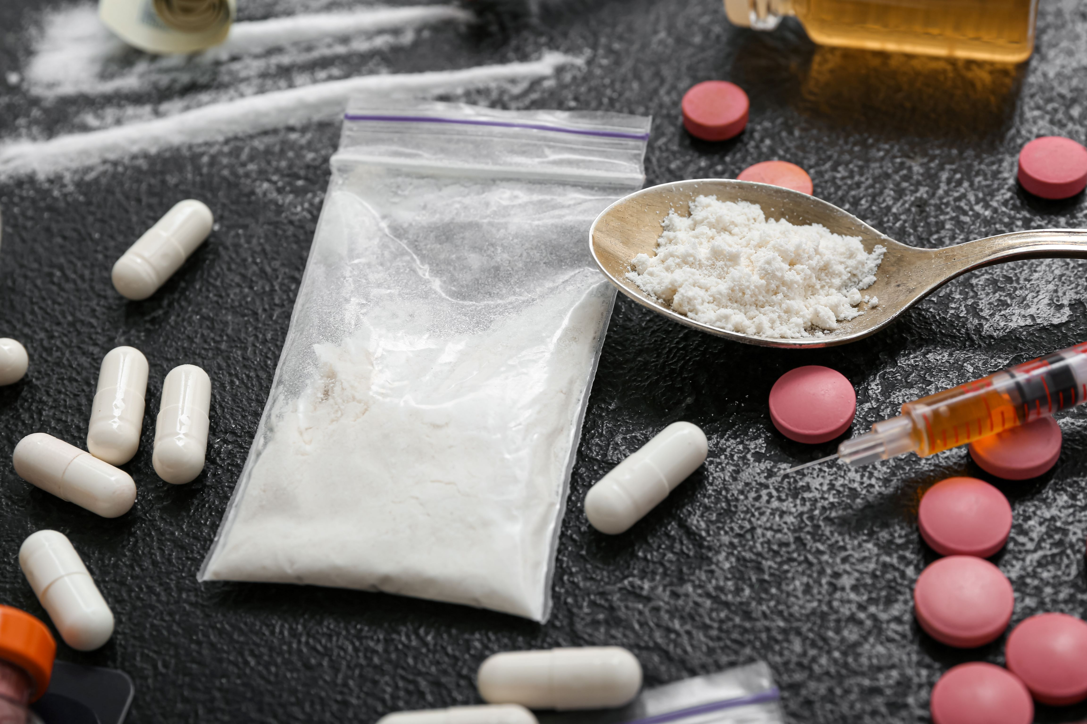
NEVER ASSUME
Working with Substance Misusing Parents

Slide 2
Webinar Programme
10:00 | Welcome & Introduction – Jane Armstrong, Co-Chair BSCP Serious Case Sub-Group and Simon Cross, BSCP Business Manager
10:10 | Case Overview and Key Learning – Joanna Nicolas, Lead Reviewer
10:40 | Quick Comfort Break
10:45 | Change Grow Live – Kerry Clifford, Quality and Governance Manager
11:15 | Question Time Panel
11:30 | Finish
www.lscpbirmingham.org.uk

Slide 3
Case Overview and Key Learning
Joanna Nicolas, Lead Reviewer
www.lscpbirmingham.org.uk

Slide 4
Background
Local Child Safeguarding Practice Review was commissioned in July 2019 following the death of a three-month-old baby.
The family - mother, father and two older siblings, aged seven and two. They were white/British.
The family was known to agencies in Birmingham, particularly the father, who had a long history of drug & alcohol misuse and criminal behaviour.
The family and extended family lived in Birmingham and the maternal grandparents helped care for the children, including taking the oldest child to school.
www.lscpbirmingham.org.uk

Slide 5
Summary of the Case
In May 2019, an ambulance was called to the family home. The baby was found deceased, and it was apparent that death had occurred significantly earlier. Both parents were arrested on suspicion of neglect. The mother tested positive for heroin and cocaine and admitted using three bags of heroin a day whilst pregnant. The father declined testing.
Both parents were found guilty of exposing Child One and Child Two to Class A drugs. The mother was found guilty of wilful neglect of the baby in October 2021. The cause of death of the baby was unascertained.
www.lscpbirmingham.org.uk

Slide 6
Eight Key Themes Identified
Effectiveness of multi-agency working
Professional curiosity
Disguised compliance
Understanding the risks to children when parents are misusing substances
Effectiveness of the in-year admissions process for education
Recognising what constitutes neglect and that neglect is a form of abuse
Children hidden from sight
Appropriate temporary accommodation for families
www.lscpbirmingham.org.uk

Slide 7
The Children’s Lived Experience
www.lscpbirmingham.org.uk
Notes:
The family had limited engagement with agencies following the birth of the baby, so little is known of the baby’s lived experience. There were no significant concerns. The home was always in a reasonable state and the parents presented well and so did the children, which is more likely not to be the case when parents are using Class A drugs
At a Learning Event practitioners indicated that there were many families that they work with about whom they have many more concerns. The oldest child did not look malnourished but one day at school disclosed that they only had five cornflakes for breakfast, another time the child said at school that a neighbour had intervened to buy them fish and chips because they had no food. This was seen as unremarkable by the school
School Two painted a clear picture for the review of what the oldest child was like but the review team has no sense as to the character of the middle child. The only word used by professionals contemporaneously to describe the middle child was “unruly”

Slide 8
Summary of Information known about the Family at the time
www.lscpbirmingham.org.uk
Notes:
The father was unemployed and spending a huge amount of money daily on his drug and alcohol addiction
The father was in and out of prison – he had received 10 custodial or community sentences between 2006 and 2019 and had a very long history of offending, mostly for acquisitive crime and violence
There was a lot of anti-social behaviour directed at the parents and the family home
The mother was arrested for stealing alcohol, both parents refused drugs tests at different times, and the mother had grown up in a family environment where the use of Class A drugs was normalised
The parents argued frequently and there was insufficient food for the children on at least two occasions
The oldest child spoke at school of being frightened of their father being arrested again and the police coming
The oldest child disclosed being hit and also sustaining a leg injury, over a short period of time. The child also gave conflicting accounts of how the injury was sustained, including that they were hit and punched in the face and when asked by whom, they said it was the middle child, who was nine months old at the time
There were also multiple missed or cancelled appointments for both the parents and the children across a range of agencies

Slide 9
Brief Chronology
www.lscpbirmingham.org.uk
Notes:
Date
Event
24.3.17
Anonymous referral to National Society For the Prevention of Cruelty to Children (NSPCC) who then made a referral to Children’s Social Care (CSC). Concerns of “parents taking and dealing drugs and children not fed properly and left to cry for hours”. Child One had said previously at school that their father smelt of “weed”. Child One’s school bag smelt of cannabis. The father had been recalled to prison for breaching his Suspended Sentence Order four days previously.
8.5.17
Child One disclosed at school that Child Two, who was 9 months old at that time, “hits me, punches me in the face”.
9.5.17
Child One seen at school with “tennis ball size bruise on leg which looked like finger marks”. Child One gave conflicting explanations for how the bruising occurred. School One informed CASS Education Officer.
25.5.17
The father was seen by prison assessor. Drug and alcohol use identified as significant factors. The father said he used £60 of heroin a day.
31.10.17
Referral to Children’s Social Care from West Midlands Police (WMP) Sex Offender Manager. Intelligence that a registered sex offender was having contact with the family. Assessment done under section 17, Children Act 1989, Child in Need.
14.11.17
The father was seen with an injury to his arm. Says he was attacked outside his house the previous evening by men with baseball bats.
29.1.18
Family presented to the Council as homeless and rehoused in temporary accommodation.
26.1.18
School One makes referral to CSC stating the family’s recent lack of engagement with professionals. The mother offered further assessment by CSC but declined the offer. Case then closed to CSC.
19.5.18
The mother attended Queen Elizabeth Hospital Emergency Department with an injury to finger which she said had been caused by punching a mirror two weeks previously. She was referred to hand surgeon but self-discharged against medical advice.
11.6.18
The mother attended the Early Pregnancy Assessment Unit. Approximately six weeks pregnant.
25.7.18
The mother arrested for stealing three bottles of whiskey in a shop and refused to give a drugs test.
2.8.18
The father was given a custodial sentence for burglary. He tested positive for Class A drugs on arrest. He said he was using £40’s worth of heroin and £40’s worth of crack cocaine every day. The National Probation Service made a referral to CSC.
12.9.18
Family moved to second temporary accommodation home.
11.10.18
The father was released from prison.
12.10.18
The Prison Service informs the father’s GP practice that he will need to be prescribed Naltrexone - a drug used to treat opioid and alcohol addiction, now he is back in the community.
Early February 19
The baby was born at home. There were significant delays in the family contacting the Birmingham Women’s Hospital Birthing Centre following the birth and bringing the baby into Hospital.
May 19
The baby died.

Slide 10
Key Themes and Learning
www.lscpbirmingham.org.uk

Slide 11
Effectiveness of Multi-agency Working
Learning Point One: Effective multi-agency working is key to protecting children.
www.lscpbirmingham.org.uk
Notes:
Practitioners, including those agencies working with adults, are familiar with expectations and requirements in respect of information-sharing in line with Right Help, Right Time guidance
Arrangements are in place for effective communication between HMP offender managers, sex offender managers, GPs, CSC and all other relevant agencies on the release of a prisoner who may pose a risk to children
All agencies working with men need to consider whether those men have children in their lives, or a pregnant partner, and the strengths and risks the individual may present to those children to inform what action should follow
Probation (and with it their links to the Prison Service) are a key partner within MASH to help facilitate effective information-sharing and co-ordination of support
The exchange of information within CASS/MASH receives prompt responses from all agencies to enable professionals to make timely and proportionate decisions
Efforts are being made to make systems across agencies more compatible which allow professionals to communicate with each other with greater ease. It should be noted this is a national, as well as a local, issue
The multi-agency referral form should be amended to allow for the inclusion of information about those agencies already involved to offer support to the family, such as Early Help, and details of the named professionals and practitioners
The quality of referrals is consistent and there is sufficient understanding of the Resolution and Escalation Protocol.
There were some good examples of m-a working but m-a working was not a strength with this family.
As I have said, there were lots of things known by single agencies, and some joined up working between prison and GP for example, but those agencies not thinking about the children and the impact of their father’s behaviour on them.
CSC did not speak to the police about the sex offender who was having contact with the children.
In August 2018, the National Probation Service made a referral to CSC with regard to father’s heroin and crack-cocaine use and the fact that the mother and two young children were living in temporary accommodation. The father had received a 26-week custodial sentence for acquisitive crimes. CSC responded to the referral the following day stating that “the referral did not meet threshold for intervention”. They stated that “there seemed to be no clear consent for intervention and no safeguarding concerns shared, father has been sentenced and is taking drugs however we need to have further details of the impact on the children and whether mother consents for support. Your referral is recorded for information purposes only”.
None of the professionals working with the family knew that the mother had convictions for threatening behaviour, assault and antisocial behaviour. This was all relevant information because she was the primary carer of the children.
3.2.8 None of the professionals working with the family knew the details of the father’s criminal history, which was long and included threatening behaviour, acquisitive crime and assaults. When he was arrested for a dangerous driving incident in 2009 there was an 18-month-old child in the car. The police found a knuckle duster and a knife in the car, that no one asked about, nor considered the child’s safety and wellbeing.
The father told the review that he and his partner were not honest with professionals about their drug use because they thought the children would be removed from their care if professionals knew about the drugs. He also told the review that the agencies he was involved with, the police, prison service, probation and health services did not ask him if he had children. It should be noted that the National Probation Service did make a referral to CSC in August 2018 because of their concerns, as set out above.

Slide 12
Effectiveness of Multi-agency Working
Learning Point Two: The Early Help and Support arrangements should highlight the importance of the lead professional role in coordinating the work of agencies involved with the child and the family.
www.lscpbirmingham.org.uk

Slide 13
Professional Curiosity & Disguised Compliance
Learning Point Three: The importance of professionals being curious is essential. This requires demonstrating respectful uncertainty and triangulating information to enable professionals to maintain a focus on the safety and welfare of children.
www.lscpbirmingham.org.uk
Notes:
Specifically, agencies should consider:
The need to continually reinforce to practitioners that they must question and consider any explanations given and be endlessly curious
Supporting practitioners to recognise and understand disguised compliance as an avoidance strategy used by some parents/carers
Professionals need quality reflective supervision, where supervisors ask probing questions, to better enable the frontline professionals to keep children at the heart of practice
The need for practitioners to view the incremental nature of changed/missed/cancelled appointments through a safeguarding lens and how systems can enable practitioners to question and challenge the pattern of avoidance and then consider what action should be taken. Not all agencies in Birmingham currently have a system for considering the incremental nature of missed/changed/cancelled appointments, which makes the system more reliant on individual practitioners. Systems must be in place to ensure practitioners question and challenge the pattern of avoidance to inform necessary action
On one occasion the mother presented at A&E. She had injured her finger, she said by punching a mirror two weeks before. No one asked her about it.
Another time the mother was arrested for stealing three bottles of whiskey from a shop. That was not explored with her.
Father arrested and admitted using £40 of heroin and £40 crack cocaine every day. No one seemed to think what that might look like in realty. Impact on children?
Father coming out of prison, no one thinking – so what?
3.2.1 The terms on which professionals worked with this family were very much dictated by the parents. The fact that the professionals liked the parents, and the parents seemed to make an effort with them, appears to have influenced how professionals viewed the family. The parents presented as plausible and too often professionals accepted what the parents said at face value.
3.2.2 A number of professionals working with the family knew that both the maternal grandparents had a history of drug misuse, as did the maternal aunt, whose child had been removed from her care. The mother was very close to her family and yet there was no curiosity around the fact that the mother had grown up in this environment and her partner misused drugs. This knowledge should have made professionals question the likelihood of the mother being an illegal drug user too. Part of the challenge was that some professionals knew about the father’s drug misuse, whereas others did not, and some knew about the mother’s family history, but others did not.
3.2.3 Child One had asthma. There can be a link between drug-using parents and children having asthma. This is something that should always be considered as a possible cause by health professionals and is also a theme which has arisen in two local child safeguarding practice reviews in Birmingham recently. This could have been an opportunity for professionals to explore, particularly as Child One mentioned their father smoking “weed” and the school had observed Child One’s school bag smelt of cannabis.
When the father was released from prison a number of professionals knew that he had been attacked and there was antisocial behaviour directed at him and the family home, but no one questioned why, nor addressed this. It was also known by some professionals working with the family that he owed “acquaintances” money, but it was not known why or what for, and those questions were not asked.
The father had been ordered to attend an alcohol treatment programme in prison, but he did not attend it and it was then removed as a requirement. There was no curiosity as to why he had not attended the programme and what the likely implications would be on his children and partner
The mother missed a number of her antenatal and postnatal appointments and there was a lack of follow up, even though there is a strong link between mothers not attending antenatal and postnatal appointments and there being a cause for concern. At the time of the baby’s birth a hospital midwife did do a lateral check when the baby and mother were admitted. They saw the family had been open to CSC but was now closed. There was no curiosity as to what CSC’s involvement had been, or why the case had been closed.
When the mother said she was not allowing a convicted paedophile to have unsupervised contact with her children, even though at the same appointment she described him as being like a grandfather to the children, this was not challenged. It was also accepted when the mother said she would not leave the children alone with this man. No consideration was given to the fact that this individual may have groomed the mother – a vulnerable mother whose partner was in prison.
3.2.15 At the same meeting the social worker did not ask why the father had been in prison previously and why he had been assaulted when he came out.
3.2.16 Child One’s attendance at School One was poor and no-one asked why.
3.2.17 The mother said she would ensure that there were rules and boundaries in place for Child One, after being involved in a fight at school. This was just accepted.
The school did not think WHY did Child One get into a fight one day, when he never usually did – it was the day after he had seen his father arrested but the school did not know that.
Disguised Compliance
3.3.1 The father told one professional that he smoked a bit of cannabis but agreed not to smoke around the children. The mother was fully aware of her partner’s drug use but would tell other professionals that he did not smoke cannabis or use any other drugs. She said he only smoked cigarettes and always outside. All of these things were taken at face value. There were discrepancies which could have been identified if the professionals involved had spoken with each other.
3.3.2 Professionals are busy, and it is understandable why, when someone seems compliant, they will spend more time focusing on individuals they are working with where non-compliance is more apparent.
number of agencies and individuals were extremely tenacious and flexible in their attempts to engage with the family, including the Think Family worker, the Paediatric Eye Service, the Community Midwife, Health Visitor Three, the Student Health Visitor, the headteacher of School Two and reception staff at the GP practice.
WHY did it matter why Child One did not wear his specs?

Slide 14
Understanding the Risks to Children when Parents are Misusing Substances
Learning Point Four: All professionals working with children and their families need to have some understanding of substance misuse and the barriers for parents/carers being honest about their drug use, and seek expert advice and input where necessary.
www.lscpbirmingham.org.uk

Slide 15
Effectiveness of the In-year Admissions Process for Education
Learning Point Five: The Local Authority must ensure effectiveness of local arrangements, and adherence to the 2014 Admissions Code, providing advice and challenge to schools and assurance to the School’s Adjudicator.
www.lscpbirmingham.org.uk
Notes:
When it became apparent that Child One was not going to return to School One, the school took advice from the Local Authority Admissions Team and were advised of “The Schools Admissions Code 2014” criteria for removing a child from roll. Child One met the criteria on distance and confirmation was given that Child One would not be returning to School One. School One then removed Child One from roll. However, the mandatory paperwork to advise the Local Authority that this action had been taken was not completed. There was therefore no oversight for Child One as a child out of school.
3.5.2 School Two has a transient cohort of children and so they liked to get as much information about children as possible before admitting them to the school. They had therefore devised their own form in addition to the standard paperwork.
3.5.3 In this case School Two failed to follow mandatory national and local in-year admission processes. The Local Authority was not advised that the parents of Child One had applied for a school place and the request for additional information caused significant delays to admission.

Slide 16
Recognising what constitutes Neglect and that Neglect is a Form of Abuse
Learning Point Six: Professionals need to recognise and understand what constitutes neglect to inform how they work with families in providing early help and sustained support.
www.lscpbirmingham.org.uk
Notes:
Specifically, when using the Graded Care Profile responsibility lies with professionals to build trust and a relationship with families, so the family feels able to be honest and open with professionals.

Slide 17
Children Hidden from Sight
Learning Point Seven: All professionals working with children and their families need to keep the child at the centre of everything they do.
www.lscpbirmingham.org.uk
Notes:
All professionals need to be given the time to build relationships with children, as well as the adults, and time to get to know each child in the family individually
Professionals need time to reflect on the work they are doing and time to research and implement effective resources to assist their work
Professionals must constantly question the effectiveness of any plan, asking themselves “So what? What is getting better for the child?”
The focus was very much on the parents and not on the children. For the professionals who worked with the father, specifically, there is little evidence they considered what the impact on any children might be of the issues they knew about or were responding to
The anti-social behaviour – parents asked to move, no one thought about impact on the children, or disrupting the behaviour, or impact on children if move – new school etc.
Paediatric eye service closed case because child not taken
Mother stealing alcohol
Focus was very much on the parents.

Slide 18
Appropriate Temporary Accommodation for Children
Learning Point Eight: Children and their families must be a priority for housing providers.
www.lscpbirmingham.org.uk
Notes:
It must be acknowledged that the level of demand far exceeds supply and until that changes children will continue to be placed in temporary accommodation that is not fit for purpose. What is important is for housing providers to consider, on a case-by-case basis, as well as generally, the quality of the provision and its suitability for children and families
The mother described staying up all night killing the bedbugs that were trying to bite her baby. The father told the review he and his partner could not understand how the baby was being bitten and it was not until they tore back the plastic lining on the travel cot the hotel provided that they found ‘nests and nests and thousands of bed bugs’.
Pros would not go there

Slide 19
Summary
What this case has shown is how very difficult it is working with drug users and identifying neglect when there are few of the outward signs often associated with parents who are on a low income and using Class A drugs, even when there is a considerable amount of other evidence.
This case highlights how vital multi-agency working is. How vital it is to understand family history, context and children’s lived experience. Each agency held a piece of the puzzle, but they were not put together to form a holistic picture of the children’s day-to-day lives. If that had been done, and professionals had had a comprehensive understanding of the children’s day-to-day lives, professionals should have been able to recognise how vulnerable these children were.
www.lscpbirmingham.org.uk

Slide 20
Comfort Break - Back in 5 minutes!
If you have a question for the Q&A session
You can submit a question by clicking on the Q&A button on the top toolbar and typing your question.
We will then answer your question during the Q&A session after the second presentation.

Slide 21
Change Grow Live Birmingham​
Webinar 2024​
​

Slide 22
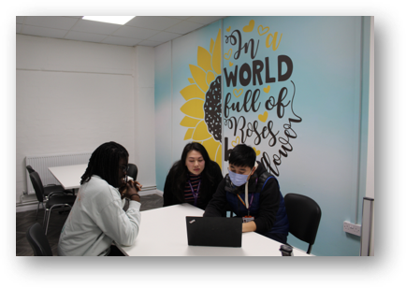
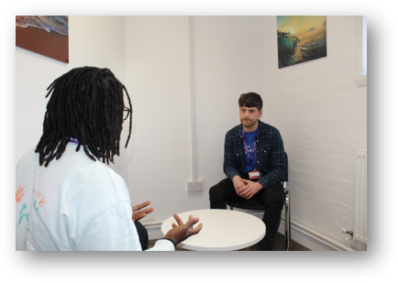
Service Overview​
​
Change Grow Live Birmingham is a free and confidential drug and alcohol service for adults. ​
We offer treatment and recovery services to support anyone experiencing difficulties with substance misuse in a range of local community and clinical settings. ​
Our recovery teams include doctors, non-medical prescribers, recovery coordinators, nurses, recovery motivators, service user representatives, and volunteers. ​
​
​

Slide 23
What we offer
Confidential advice and information about drugs and alcohol
A tailored package of care
Healthcare clinics and blood-borne virus testing
Residential detoxification and rehabilitation options
Ambulatory detox in our hubs
Throughcare (group sessions from our recovery motivators and partners)
Harm minimisation
Needle Exchange, naloxone and safe storage
Shared Care (1-2-1 sessions in your local GP surgery)

Slide 24
How to access our service:
We offer services to support anyone experiencing difficulties with drugs/or alcohol. We take self-referrals and referrals from partner agencies.
All referrals can be made quickly and easily via our website: https://www.changegrowlive.org/drug-alcohol-service-birmingham/referrals
You can also contact us via our single point of contact 0121 227 5890 or Birmingham.info@cgl.org.uk
If someone is not sure if their drug/alcohol use is problematic, we have an online self assessment that anyone can access anytime.

Slide 25
We’ve got specialist teams…​
Homeless and Rough Sleeper team​
Criminal Justice team​
Women’s team​
IPS (Employment) team​
Through Care (group and recovery sessions)​
LGBTQ+ Group​
Veterans’ group​
Service user representative group​
Prison Leavers/Buvidal project ​
Tele-triage team​
Hep C team
Hospitals team​
Let’s not forget our large cohort of volunteers trained in BBV testing, screening and motivational coaching. ​

Slide 26
Multi Agency Working
Key agencies:
Birmingham Children’s Trust
Specialist midwives : Women’s Hospital, Heartlands, Good Hope and Sandwell and City
Criminal Justice
Housing
Adult Social Care
DA agencies
Notes:
Specialist midwives & maternity, Our specialist women’s team meet on a regular basis with the substance misuse midwives to discuss concerns pregnant service users across the service and share concerns, identify safety plans and professionals involved.
Police, Probation and our prison release team.
Housing- we have a homeless team at CGL in the centre of Birmingham and as such we liiaise closely with Birmingham city housing and local housing providers.
Adult social care-referrals are made, and multi-agency meetings attended to discuss complex cases and safety plans.
Women’s aid, Anawim. We work closely with several of our clients experiencing/experienced domestic abuse in addition to the problem-solving court team for women at risk of a custodial sentence. CGL have a Marac coordinator who chairs MARAC meetings and delivers training workshops to our team of recovery coordinators and team leaders.
Children’s social care – attendance at core group, CP, ICPC & CIN meetings. In addition, we have appointed a CASS & MASH worker who works from children’s services to support lateral checks within CGL.
Referrals- for early help and child protection are made when concerns are identified.

Slide 27
Multi Agency Working continued
Family Drug and Alcohol Court Team
Family Hubs
Aquarius
Acute Hospitals
Birmingham and Solihull Mental Health Foundation Trust
Notes:
CASS checks are completed with consent but if clients are presenting as well and are known and closed to BCT the initial reason for being brought to their attention is not shared with us and we are unclear as to why the file was initially opened.
Early help hubs-CGL are now placed within the family help hubs in East and Central &West, the aim is to be city wide and to capture clients and their children at the earliest point of substance misuse/recovery.
FDAC, Aquarius-MPACT- We have several clients going through the FDAC programme and support their recovery. M-PACT programme is being rolled out to support children and parents with understanding of the impact of substance misuse.
Hospital teams –liaising with Lead social workers - increased our hospital team capacity and role of recovery workers within the hospital team to undertake triage and detailed assessment.

Slide 28
Engaging those with parental substance misuse
Engagement stage
Challenging stigma
Reducing barriers
Service User led risk assessments
Specialist teams
Notes:
At CGL we work with adults from the age of 18. Many are misusing illicit substances such as heroin, crack, cocaine in addition to alcohol. Clients can self-refer, or other professionals can refer them for support. During the triage stage we aim to gather information to aid assessment of need, but this is not always possible due to their presentation. Information shared is sometimes minimum and avoidant where children are concerned.
Parents are worried about the implications of sharing they have children, caring responsibilities and are in need of our service, as the fear referrals to children’s social care will be made and their children will be removed.
Working with adults to build trusting relationships to illicit sensitive information is difficult under most circumstances and, when working with many of our clients who have suffered adverse childhood trauma and adult trauma, it is even more so.
The difficulties we experience are when clients do not share information as to whether they are a parent or have caring responsibilities. Without consent we cannot complete CASS checks, and without evidence of concern a referral is not made.

Slide 29
Working with our service users
Service user involvement lead
Lived experience and volunteers
Staff training and development
Involving others : family, involved others, professionals
Treatment offers
Notes:
We use motivational interviewing to enable clients to set goals taking careful consideration to our values of care and compassion, this helps to build trusting relationships whereby clients open up and share sensitive information. Using techniques of avoiding arguing against resistance, avoiding confrontation, finding other ways to communicate and shift perceptions and enabling the client to be an expect of their own problem solving.
Multi-agency working will be essential in such cases as not one agency has the scope to deal with multiple problems. (Galvani 2008)
We offer group work, acupuncture, Reiki and 1:1 sessions to support clients through their recovery.
Trauma informed practice enables our staff to engage with clients with greater understanding of their experiences and needs. Our national L&D team have developed additional training around trauma informed care with 12 month supervision built in which is being rolled out across our service.

Slide 30
Recovery focused treatment
Building on engagement
Visible recovery
Engaging other professionals
Consistency
Non-judgmental
Notes:
At CGL we challenge the stigma around parental substance misuse by being open and honest and building trust with our service users. By promoting positive professional relationships with partner agencies. This improves the outcomes for parent and child’s safety and well-being.
At CGL we undertake joint work with professionals to ensure our clients feel supported and understand the value of engaging with all professionals.
Breaking down the barriers to engagement by highlighting the benefits of treatment and recovery. We link service users in with all mutual aid support and relevant links within their own communities. Building on personal relationships and involving family and friends networks.
Being consistent with our service users is key, we offer appointments in the early stages of their treatment and our recovery workers are fully aware of the difficulties our clients face when coming into treatment. It may take several attempts to engage in the triage process and early assessment before the service user feels confident enough to engage.
The non-judgemental approach and the level of persons with lived experience that work within CGL contributes to this positive understanding and engagement.

Slide 31
Professional curiosity
Challenges for staff
Engaging other professionals
Information sharing
Learning from cases and how to embed best practice
Ongoing development and reviews
Notes:
Effective communication is key to professional curiosity, being able to have sensitive conversations and challenge appropriately is imperative to recognising disguised compliance and identifying risk.
CGL is a voluntary agency and therefore it is not compulsive for clients to engage, share information or access treatment. However, we know that it is extremely important for our clients to manage their addiction for physical and mental health reasons and therefore it is a skill to manage these difficult conversations whereby our workers need to build relationships, challenge and safeguard children.
Sharing such information can be a barrier to coming into treatment. During the triage assessment and our entry into service we attempt to capture as much information as possible. Recovery coordinators talk about a typical day for the client, capturing the substance misuse, family/friend relationships, history, mental health, other professionals involved, domestic abuse, criminal activity finance and housing. This provides a holistic assessment of need and risk to inform decision making around child protection and vulnerable adult safeguards.
DEVELOPMENT
We continue to work with staff to support and build on their professional curiosity through supervision, training and professional development. The drive is to improve the communication skills of staff to address their curiosity and recognition of disguised compliance. This will be addressed through our induction programme, ongoing internal training, external training (BSCP)and regular safeguarding clinics to address complex situations.

Slide 32
Recognising neglect as a form of abuse-being child focussed
CGL offer training and workshops to clients to empower and improve knowledge around the impact of substance misuse, hidden harm and the links between neglect and emotional abuse for children when parents are misusing substances.
These workshops address:
Positive role modelling
Funding addiction – the implications
Stability - what this looks like and how it makes a difference for a child
Keeping your children safe; physically and emotionally
Health risks; to client and child
What you can do to help - motivation to change, support networks
These workshops provide an opportunity for clients to rate their parenting before and after the session/treatment. This empowers clients to address their substance misuse and see positive changes as they progress through their treatment.

Slide 33
Hidden Harm forms of abuse
Neglect
Lack of consistent support, recognising and responding to their own and child’s physical needs, financial implications leading to debt, lack of provision due to spending money on drugs and alcohol. Risk of harmful substances in reach of children.
Emotional
Parents are less responsive to their babies
Less willing to engage in play
Less able to respond encouragingly to further interaction
Psychological
A child can be preoccupied with their parent’s substance misuse
A child can blame themselves for their parent’s behaviour
A child can find it difficult to engage in education
A child can find it difficult to establish and maintain healthy relationships
A child can develop behavioural, emotional or cognitive problems

Slide 34
Hidden Harm
Research
Kearney, P. Levin, E. Rosen, G et al (2003) suggested; Interagency working and good cross-sector working relationships is imperative. Services aimed at adults usually do not have the expertise to deal with children's problems and vice versa. Effective service provision can be achieved by effective collaboration between children's and adult services. Falkov (1995) agreed that one of the main risks to children is when adult services and child protection services do not understand each other or communicate adequately.
This was over 20 years ago and unfortunately, as we can see in the review, multi agency working is still not where it needs to be to safeguard children effectively.
More recently Dame Black’s review recommended an increase in numbers of psychologists, nurses and social workers within drug and alcohol services therefore, CGL have embedded allied professionals into the service to provide an all-round holistic assessment of need with expertise in safeguarding and the impact of substance misuse.

Slide 35
Case Study
Last January I found out I was pregnant and from that day I got myself into recovery and stopped using drugs. My mental health took a turn for the worse and I was changed to be under the care of the women and families team at CGL. I stayed clean until I had a brief relapse in May 2023.
Thanks to recovery coordinator she got me into a treatment centre within a week where I could safely stabilise on a medication called methadone. I went there for 2 weeks, the place was called Park House and is also managed by CGL. The staff there were absolutely fantastic and I rediscovered my love for recovery whilst I was in there. I had my baby in August and my recovery coordinator put together a specific care plan that would work around me and my other appointments. This helped immensely as I already had lots of appointments to get to so this specific care plan meant I wouldn’t get overwhelmed with appointments.
My little boy is 4 1/2 months old now and I have stayed clean ever since going into Park House in June 2023. CGL women and families team continue to be there for me and are now going to assist me in reducing my methadone. I can’t praise them enough.

Slide 38
Thankyou

Slide 39
Q&A session
You can ask a question by either:
Raising your hand and unmuting your microphone when prompted.
OR
Click on the Q&A button on the top toolbar and type your question.
www.lscpbirmingham.org.uk

Slide 40
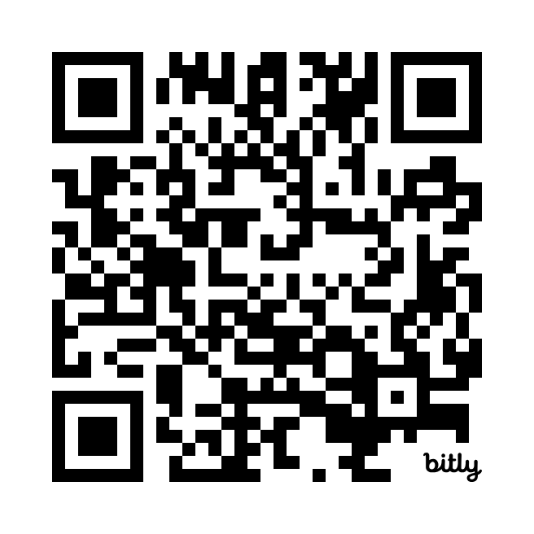
Sign up to our BSCP quarterly newsletter!
Safeguarding News Partnership Updates Training Opportunities

